Slide 1
CTF Beginner’s Guide Spenser Reinhardt – Detection Response Team
Notes:
https://www.google.com/fonts#UsePlace:use/Collection:Exo+2

Slide 2
Reversing with Radare2 Spenser Reinhardt – Detection Response Team
Notes:
https://www.google.com/fonts#UsePlace:use/Collection:Exo+2

Slide 3
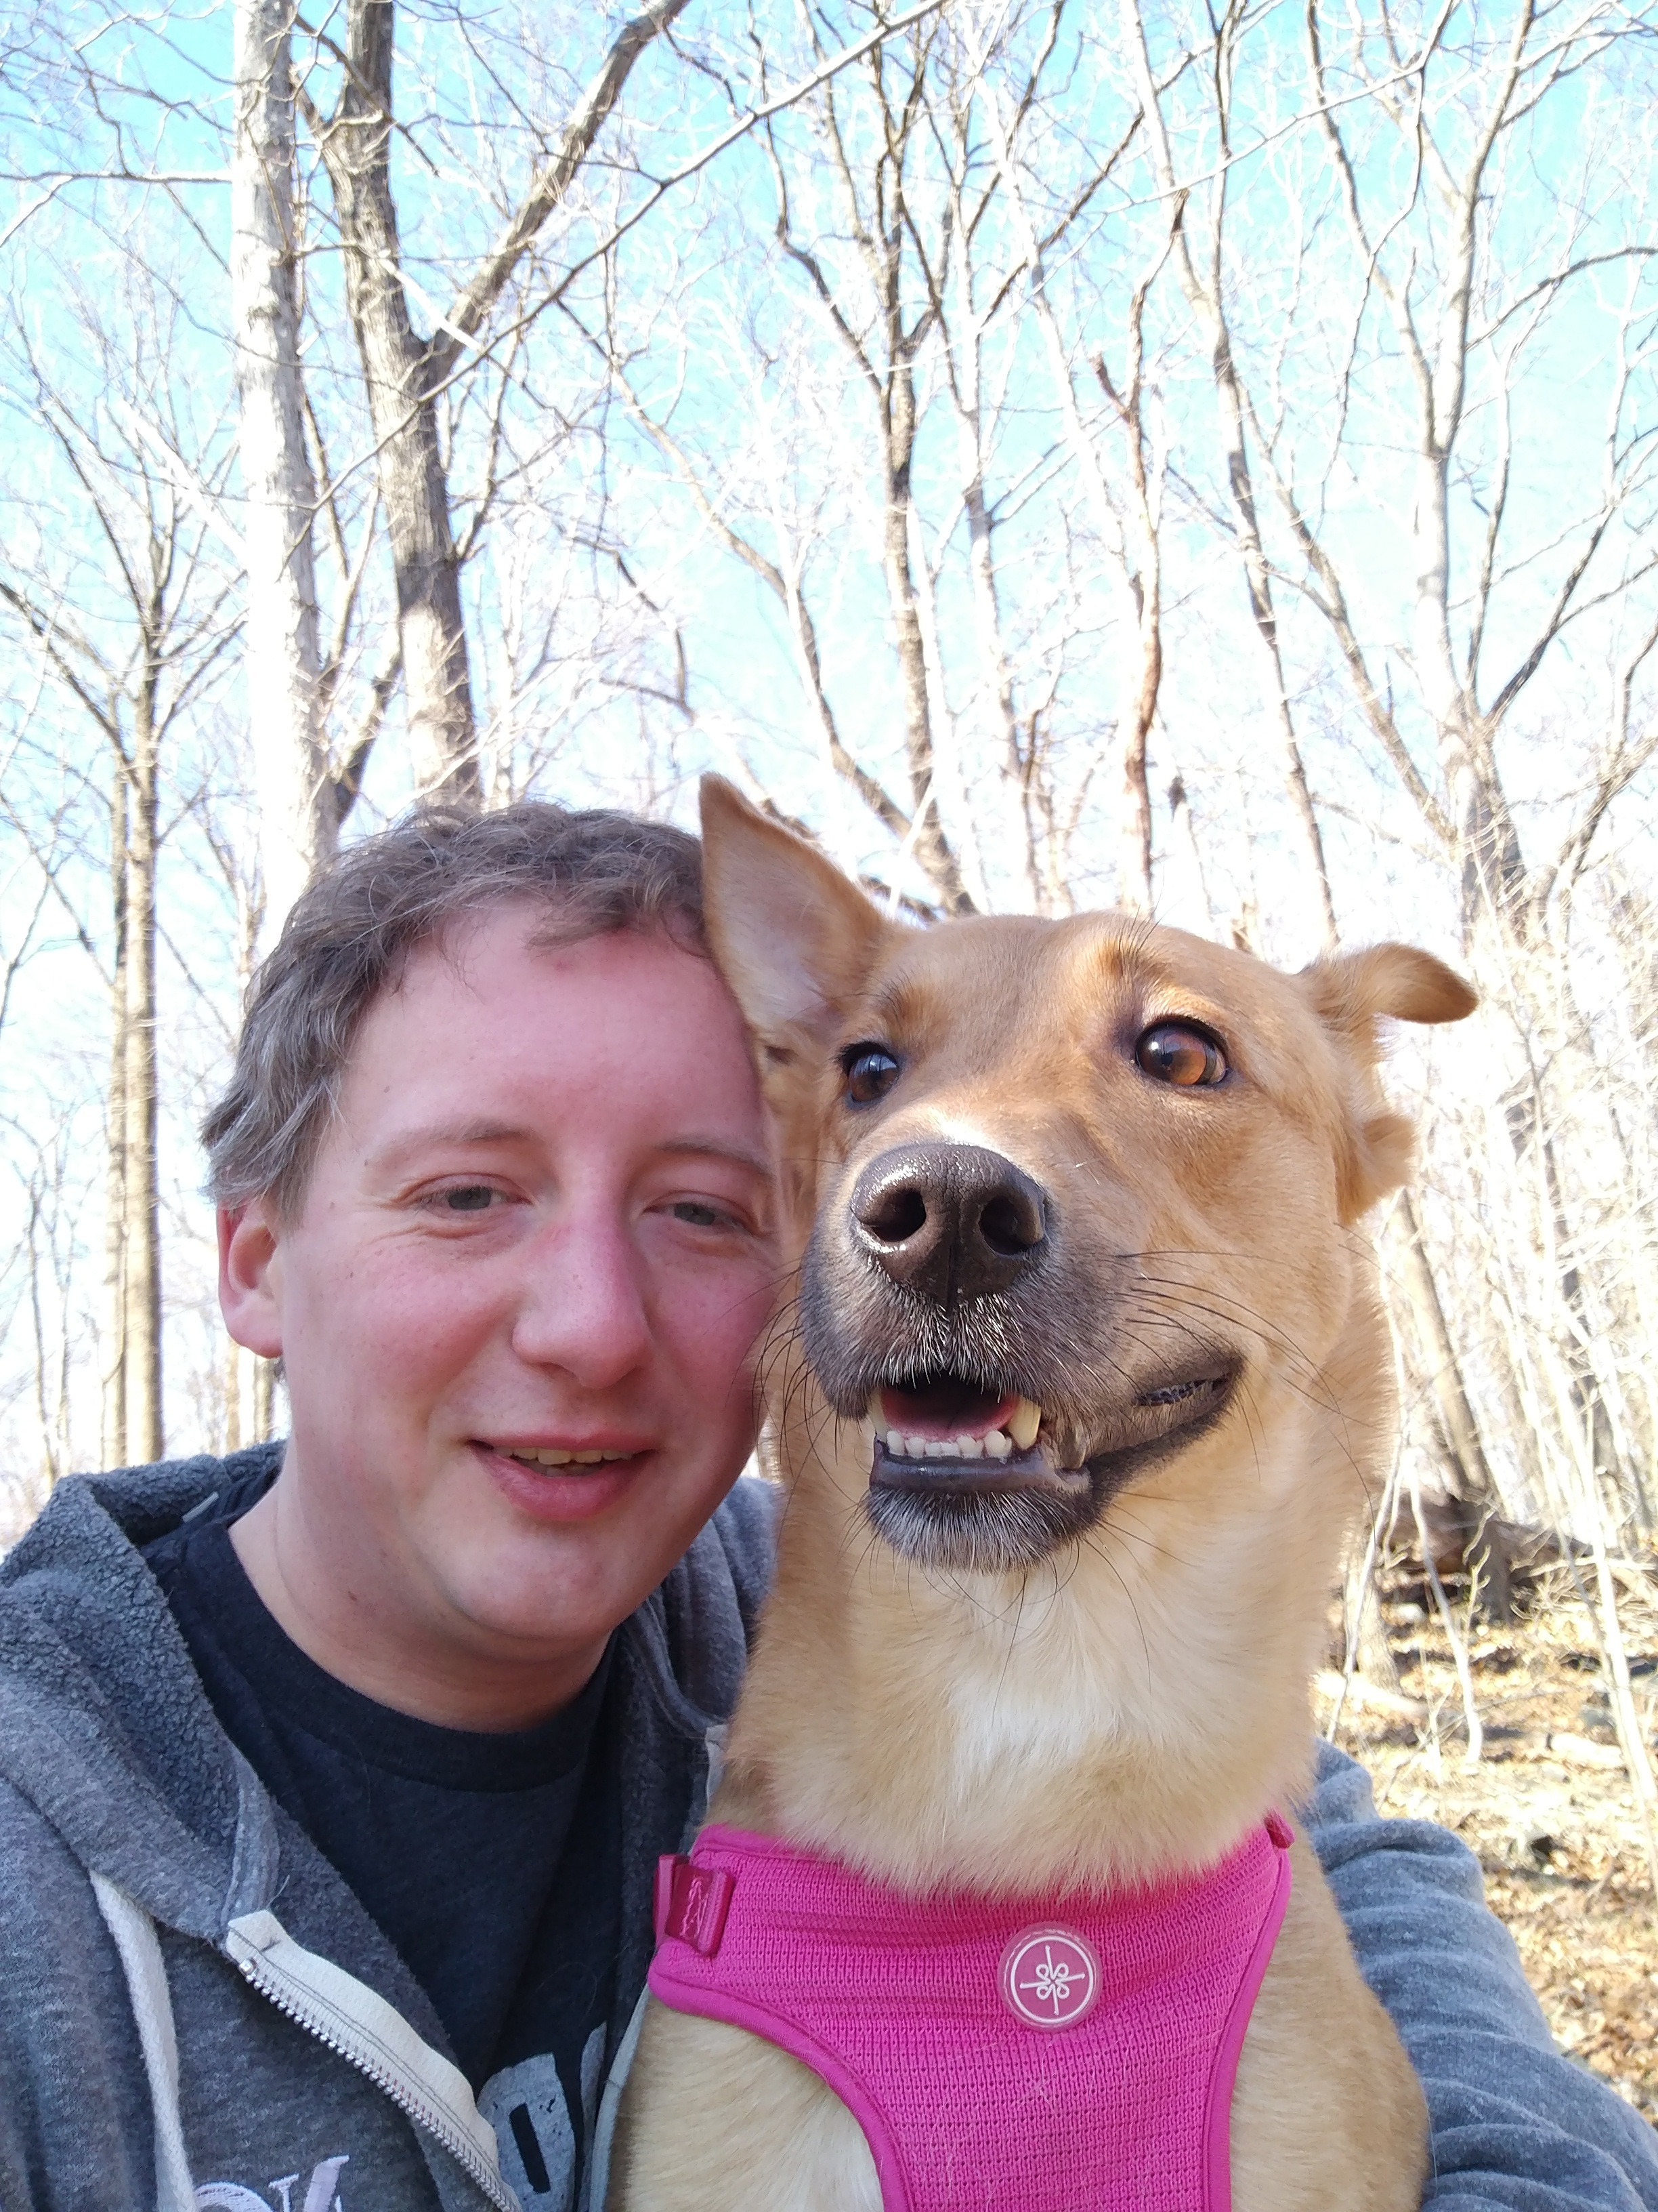
Who Am I?
Minnesota -> Michigan -> Maryland
Work Stuff
Helpdesk (Managed Services)
Desktop Admin (Healthcare && Financial)
Specialized Support/Development (Startup)
Senior Research Engineer (Talos)
Languages
Python
C/C++
ASM (x86/x64/mips/ppc)
Rust
Def Con Goon (NOC)
Team Shellphish (UCSB)
The Internet Explorerers (Talos)

Slide 4
What is CTF?
Capture The Flag (CTF)
CTFs are events hosted online or held at InfoSec conferences, that consist of a set of challenges of varying difficulties and skillsets required to complete each challenge.
Constraints
Time based, usually 1 weekend
Solve challenge -> Get flag -> Score points -> Win Prize!
Benefits
Challenges with known solutions
Unrestrictive way to learn new skills & techniques

Slide 5
Types of CTFs
Challenge Categories
Programming
Cryptography
Steganography
Mobile Devices
Embedded Devices
Reverse Engineering
Binary Exploitation
Web Exploitation
Team Styles
Red Team only
Red & Blue Team
Game Styles
Attack and Defense
Jeopardy
Progressive

Slide 6
Beginner-friendly CTFs
CSAW
https://365.csaw.io/
PicoCTF
https://picoctf.com/
Microcorruption (embedded)
https://microcorruption.com/
Google CTF
https://capturetheflag.withgoogle.com/

Slide 7
CTF Alternatives
Hack This Site
https://www.hackthissite.org/
W3Challs (pentesting)
http://w3challs.com/
Mobisec (mobile)
https://mobisec.reyammer.io/
RingZer0 Team (binary)
https://ringzer0ctf.com/challenges
PwnAdventure(|Z) (game emulation)
http://sourcery.pwnadventure.com/
https://github.com/Vector35/PwnAdventureZ
Notes:
https://store.steampowered.com/developer/zachtronics
https://resources.infosecinstitute.com/tools-of-trade-and-resources-to-prepare-in-a-hacker-ctf-competition-or-challenge/
https://hackthebox.eu
https://

Slide 8
CTF Tools

Slide 9
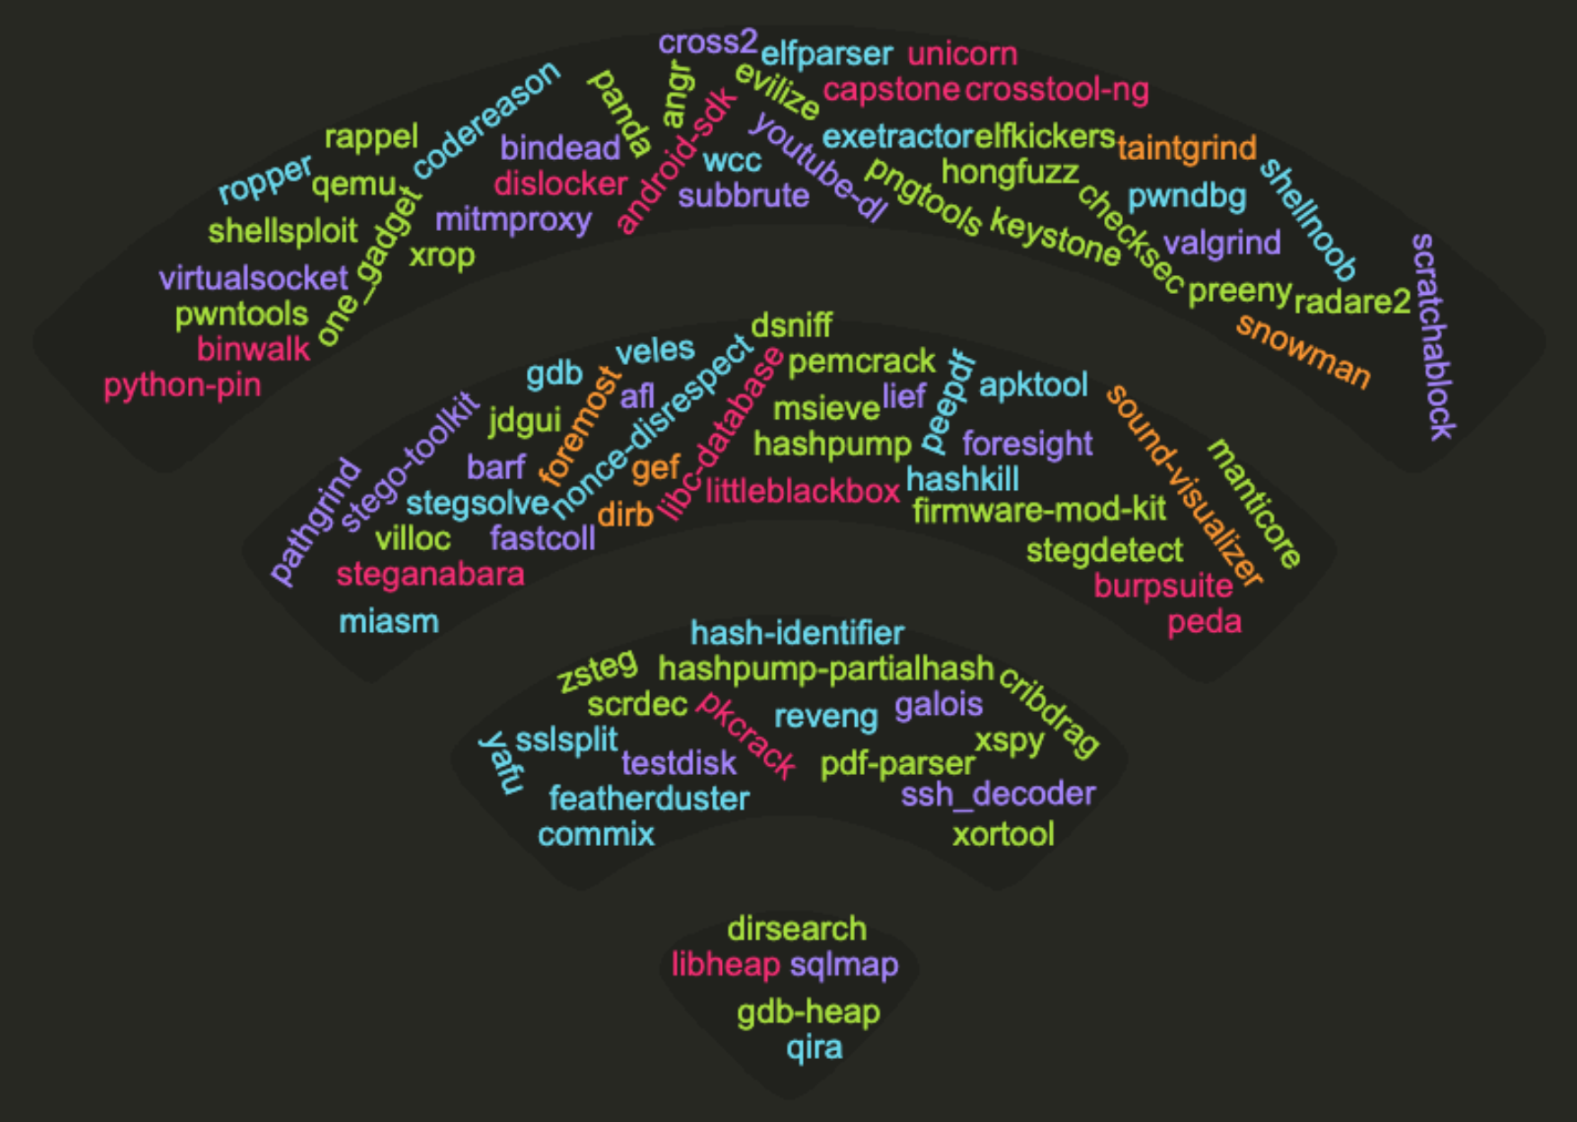
Notes:
This is just to show that there are LOTS of tools available, in the speaking notes, there are links to a few locations I find most useful!
https://github.com/zardus/ctf-tools
https://trailofbits.github.io/ctf/forensics/
https://code.likeagirl.io/ctf-beginner-guide-by-a-beginner-3c86e4959fcc?gi=a9947d9b5cd4
https://steemit.com/linux/@davidk/ctf-tools-and-hackingtools-exhaustive-list-of-hacking-tools
https://www.kali.org/
https://blackarch.org/
https://www.pentoo.ch/

Slide 10
Todays Tools
Notes:
Today we'll be working with two of these three, although generally I would use radare2 for debugging in this situation it was not needed.
IDA Pro is considered a reverse engineer's tool of choice, any licensing starts around $1200, although there are student licenses with restrictions
Binary Ninja is a new debugging/disassembly tool and is reasonably good. There are currently no free licenses aside from a demo, although it is reasonable at $150 for persona/students
Radare2 is one of my personal favorite tools, although its more than a single tool. R2 is my go to for linux debugging, exploit verification, and shellcode creation due to tools like r2asm, and its python interaction.
https://binary.ninja
https://www.hex-rays.com/products/ida/
https://rada.re/r/

Slide 11
Source Code Analysis
Notes:
Alright, let's talk about some source code! Normally we wouldn't have this in a CTF, but since this one is long past its prime Trail of Bits released everything!

Slide 12
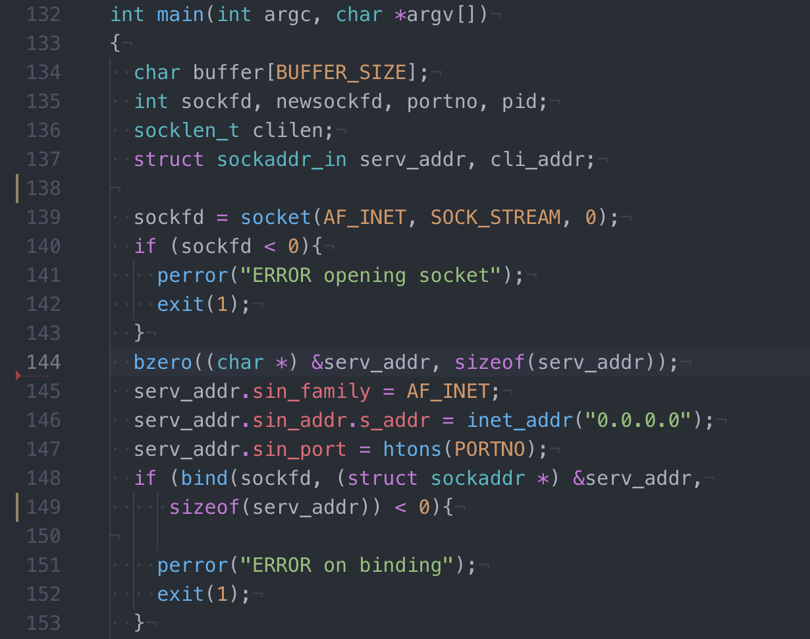
main(int argc, char **argv)
Notes:
Here we have the main function. We can see it initializes a network socket called sockfd and begins listening on all IPv4 interfaces with port 12346.

Slide 13
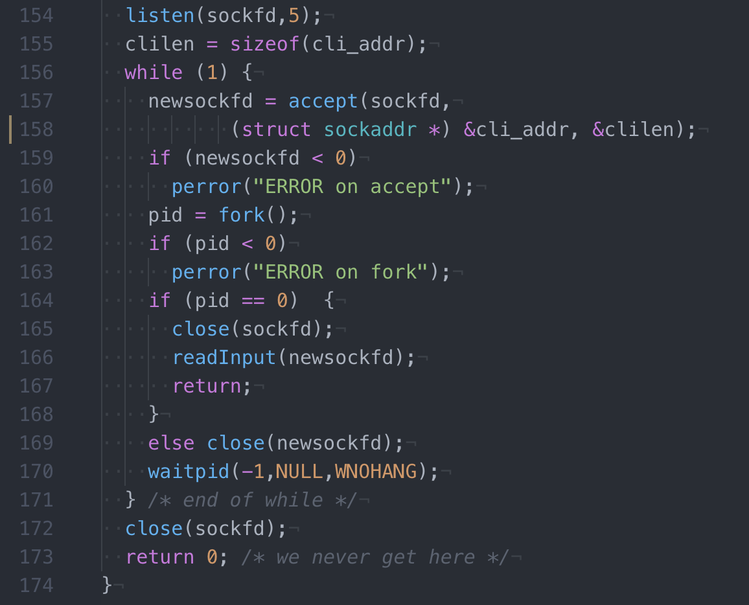
main(int argc, char **argv)
Notes:
Continuing on with main, the server begins listening on the bound interfaces and waiting for client connections. While waiting for connections, we are within the while(1) loop on line 156. It simply waits for new connections, forks child and parent, and in the child process begins playing the game via readInput(), passing along the child connection via newsockfd

Slide 14
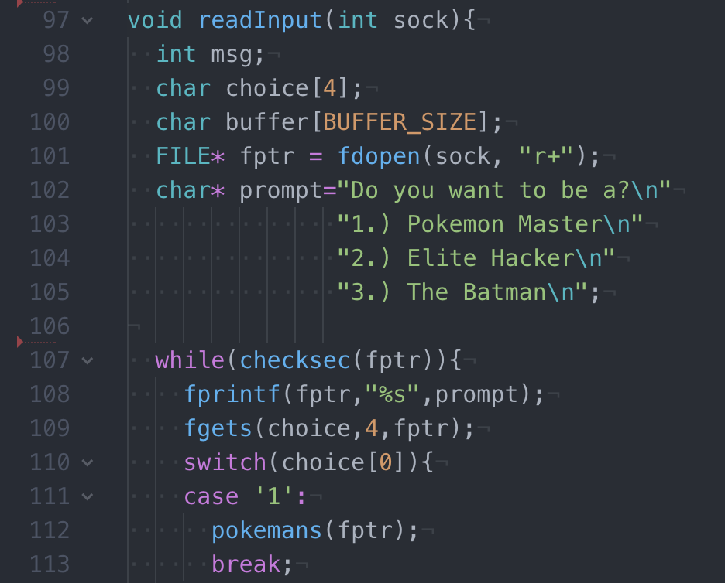
readInput(int sock)
Notes:
Read input, is where our gameplay starts. We really don’t do much before entering the while(checksec) loop. At that point though, we send the user a prompt asking which portion of the game to play and await their response. Once found we check the first byte of choice variable to see which option they chose. It is choosing a single byte as you would normally send a digit and newline.

Slide 15
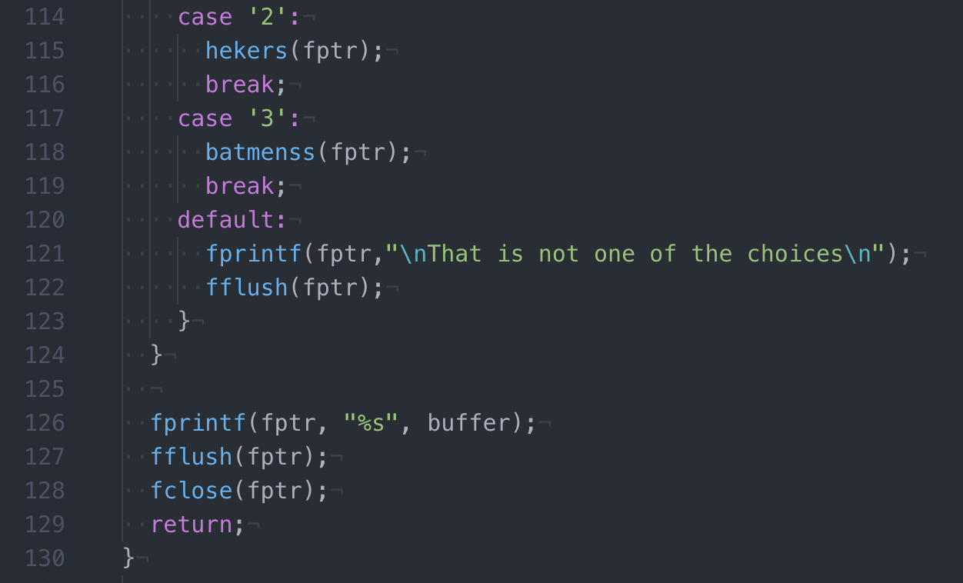
readInput(int sock)
Notes:
The remainder of readInput is also pretty benign. We finish up the case checks for which portion of the game, and have a handler for when clients are done to clear and close client connections.

Slide 16
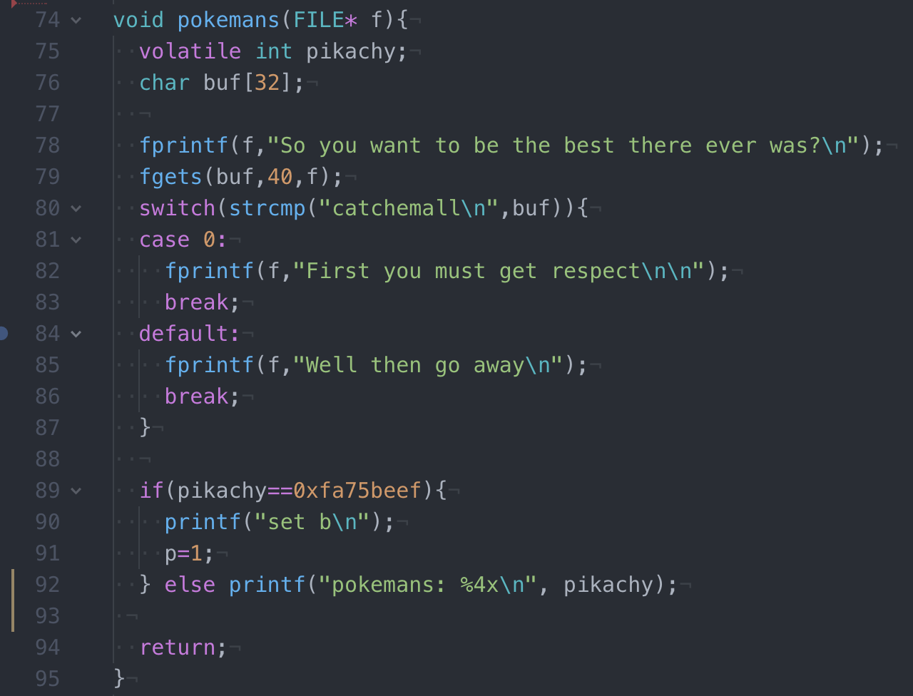
pokemans(FILE* f)
Notes:
Let’s take a look at one of the game modes, for lack of a better term. Pokemans isn’t too complicated… right? Seems that it sends a question to the player, waits for a response, does some checking of it, and sends either a correct or incorrect message back. Finally it checks if a variable pikachy is set to a particular value ”fats beef” and sets some other value P to 1. Right, not too complex, but we’ll come back to this later.

Slide 17
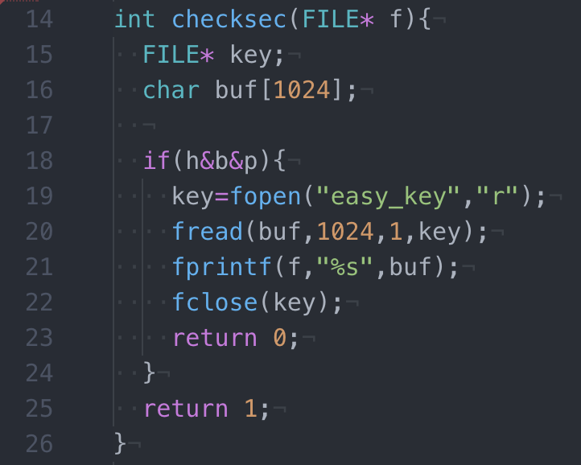
checksec(FILE* f)
Notes:
Finally let’s look at that checksec function from way back in readInput. If you remember it was called at the top of each loop iteration, and as you might guess there’s a good reason for this! Looking at its code, we can see that the first thing it does is check if values h, b, and p are set properly, if so it opens and sends the flag… wait what, that’s just what we want! How do we make that happen?

Slide 18
Binary Analysis
Notes:
Before we jump into how to make checksec send us the flag, lets take a look at the actual challenge binary, as we would see it in a CTF.

Slide 19
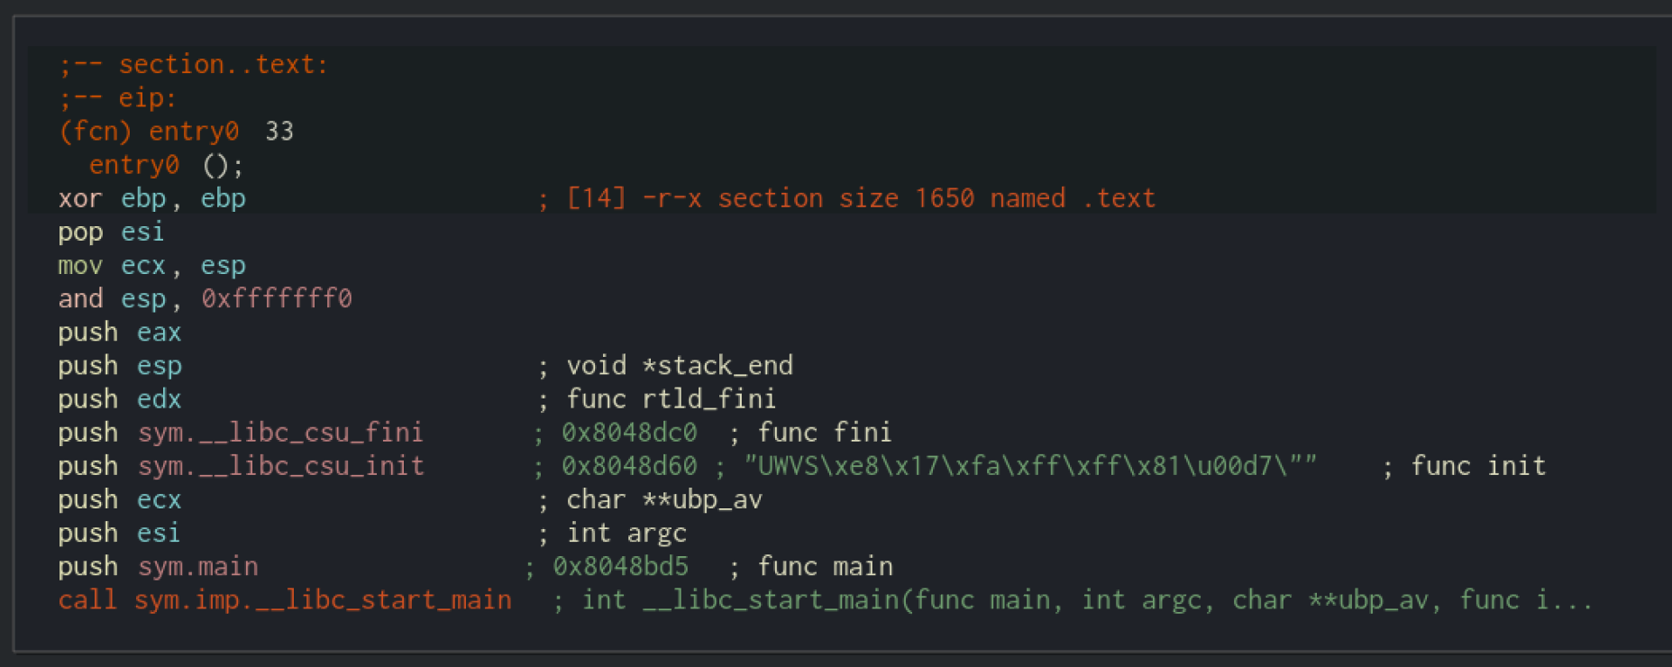
.start Radare2
Notes:
.start or _start is a perfectly valid starting place for most binaries. From this we can see libc initialization, indicating this is a C program, and just before the call to libc_start_main we have a push for the main function, that’s where we really want to start!

Slide 20
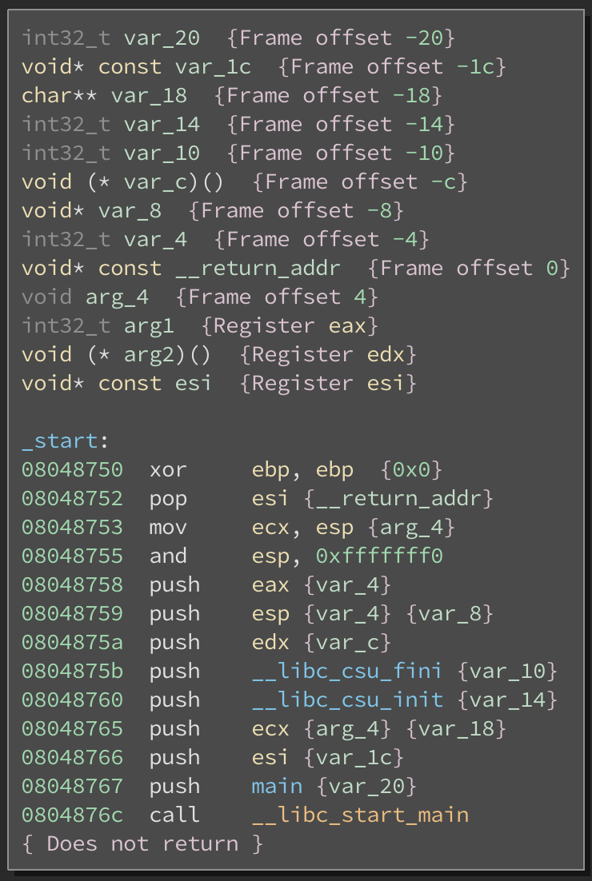
.start Binary Ninja
Notes:
.start or _start is a perfectly valid starting place for most binaries. From this we can see libc initialization, indicating this is a C program, and just before the call to libc_start_main we have a push for the main function, that’s where we really want to start!

Slide 21
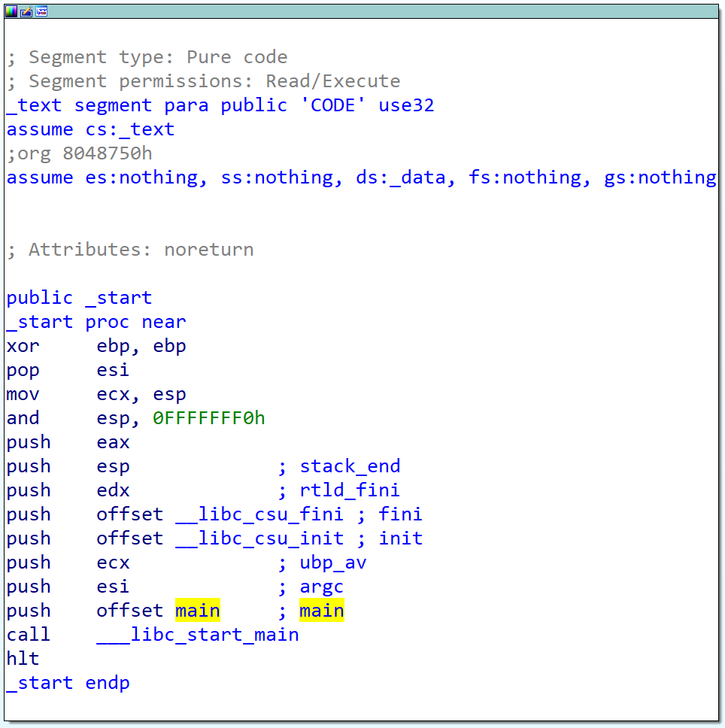

.start IDA Pro

Slide 22
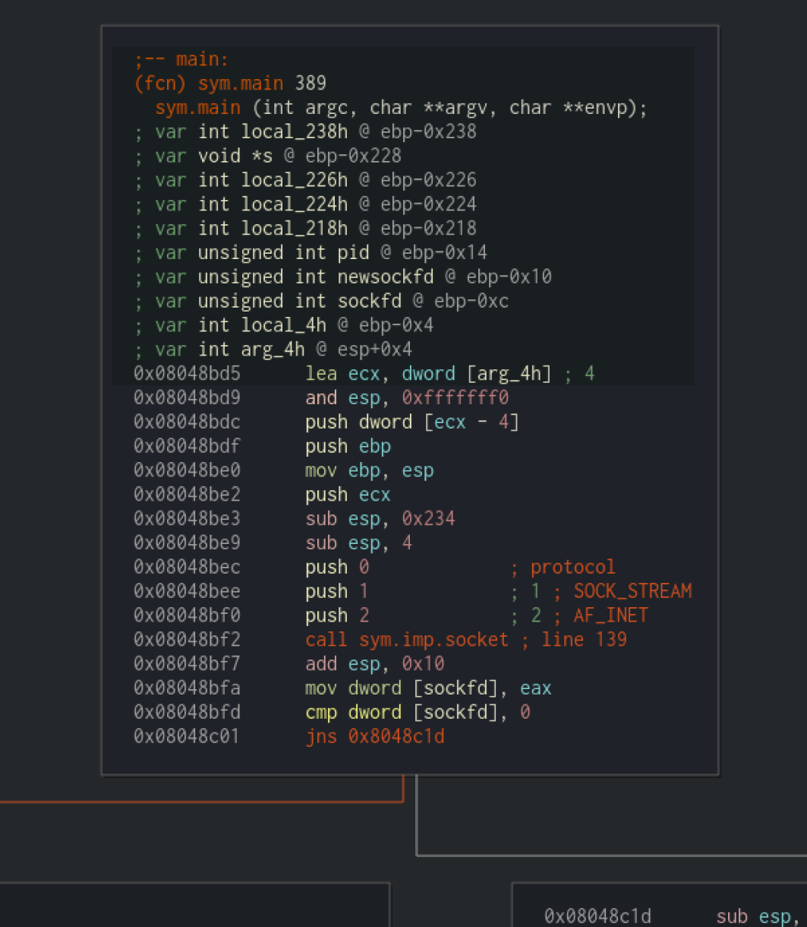
main(int argc, char **argv) Radare2
Notes:
Moving into main, this gets a bit complex and takes a few slides, feel free to reference back to source code too. Right of the bat, we can see it initializing a socket and checking that it was done correctly.

Slide 23
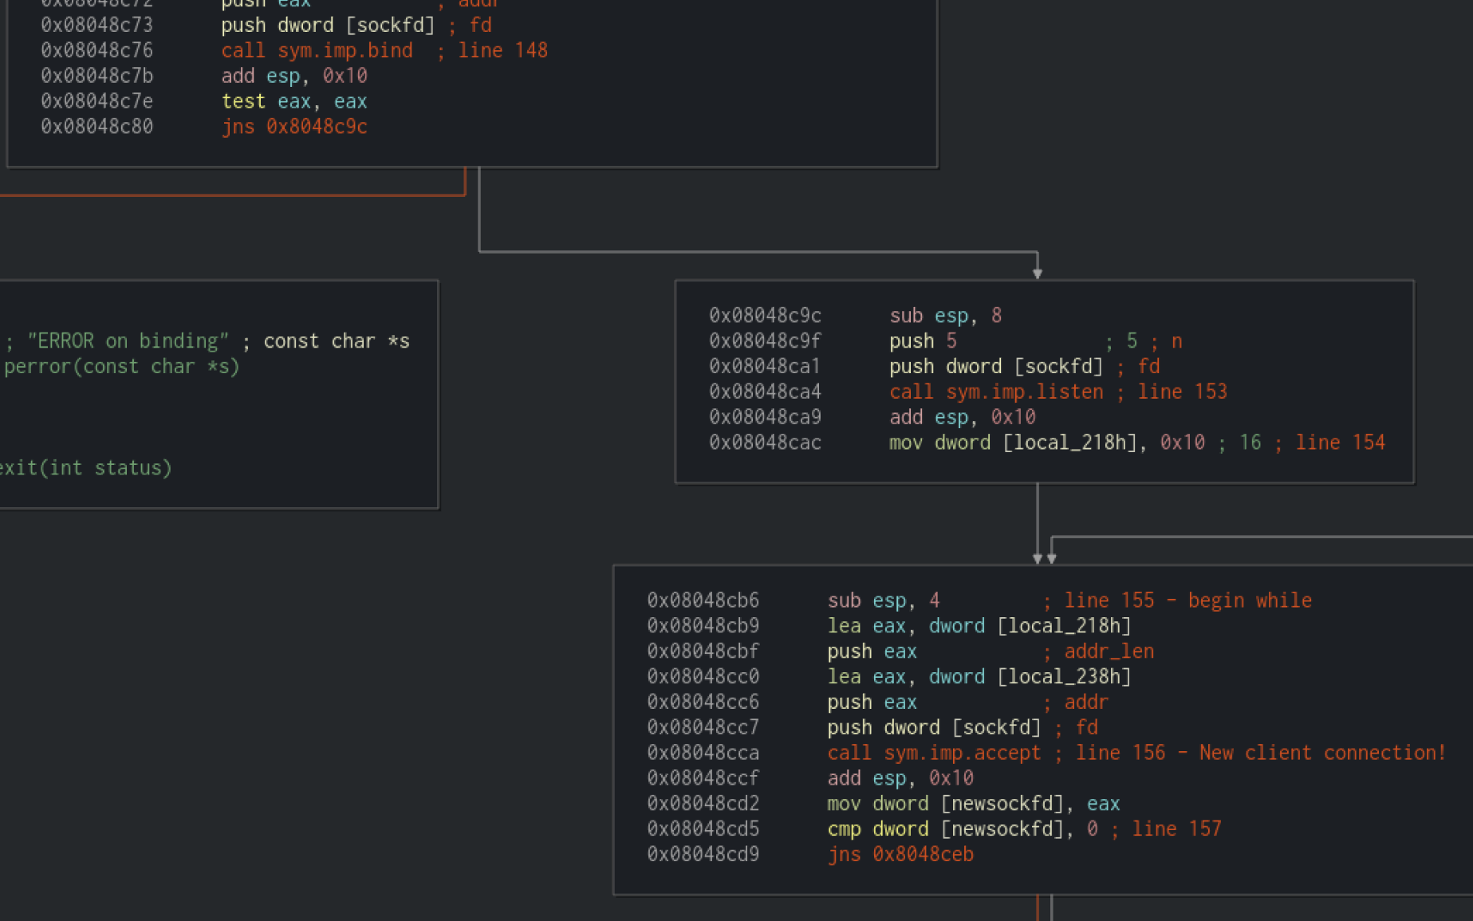
main(int argc, char **argv) Radare2
Notes:
Further down we see calls to bind, listen, and accept. As you might note by either multiple arrows or from source, accept is actually inside our while loop waiting for client connections.

Slide 24
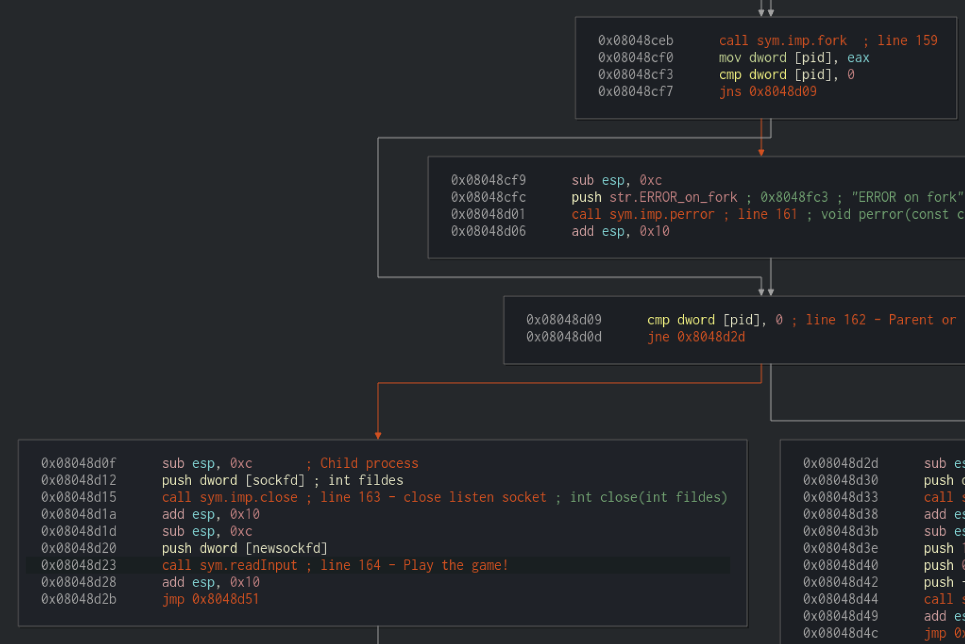
main(int argc, char **argv) Radare2
Notes:
Once main accepts a client connection, recall that it forks to separate child(game session) and parent processes; so that the parent can continue serving for other clients, and child can play a game session with each new client. We can also see the call to close, in child processes, and readInput where game play actually happens.

Slide 25
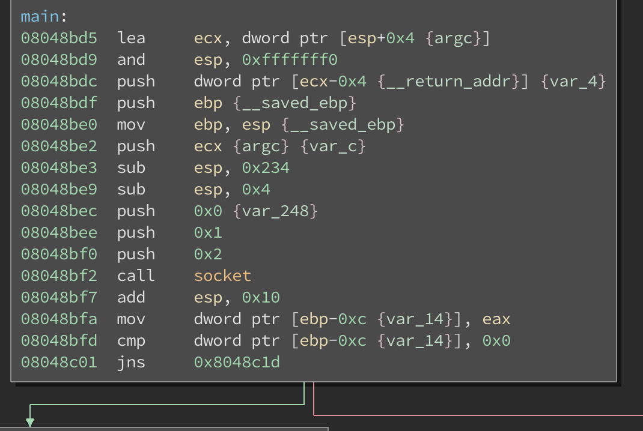
main(int argc, char **argv) Binary Ninja
Notes:
Moving into main, this gets a bit complex and takes a few slides, feel free to reference back to source code too. Right of the bat, we can see it initializing a socket and checking that it was done correctly.

Slide 26
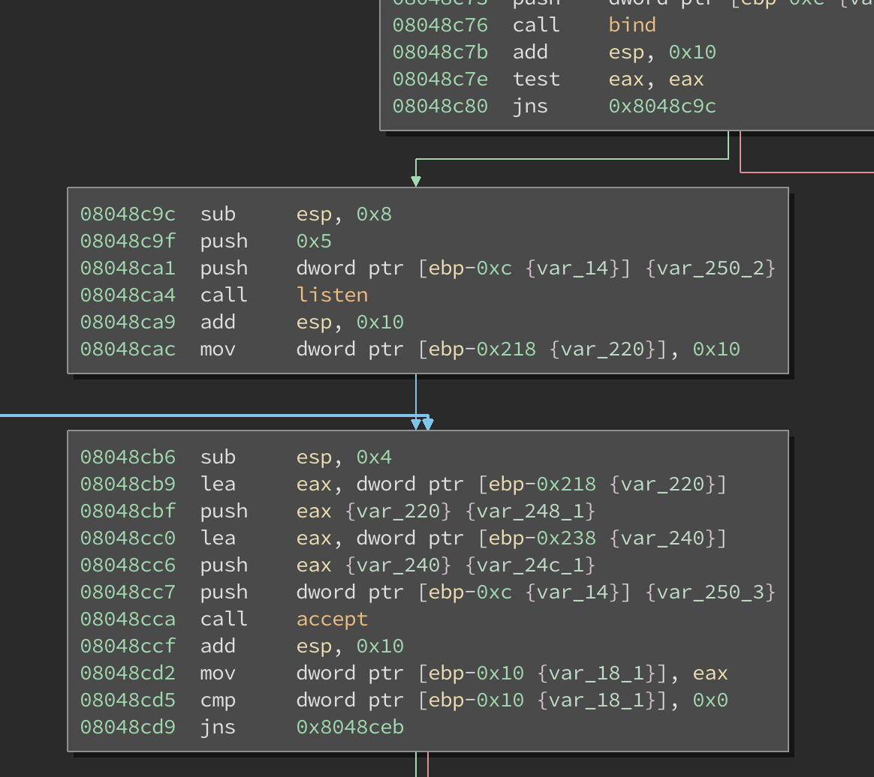
main(int argc, char **argv) Binary Ninja
Notes:
Further down we see calls to bind, listen, and accept. As you might note by either multiple arrows or from source, accept is actually inside our while loop waiting for client connections.

Slide 27
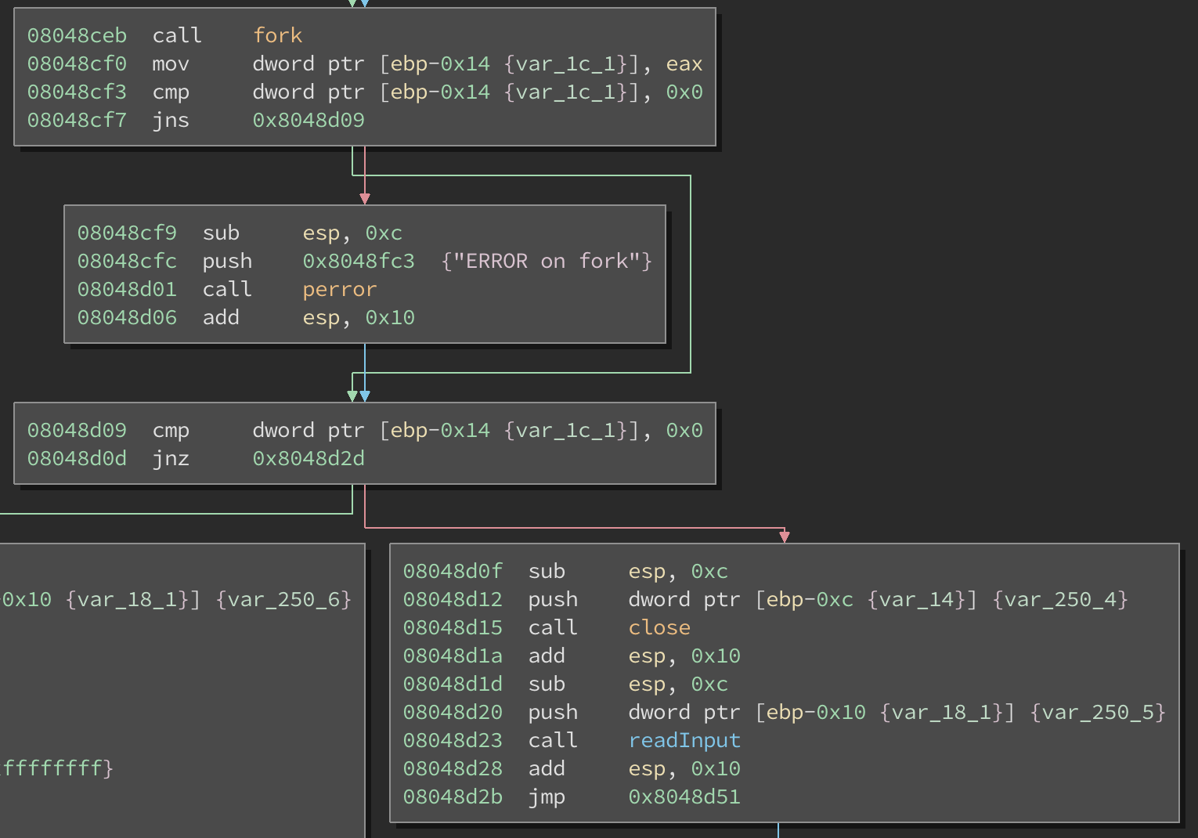
main(int argc, char **argv) Binary Ninja
Notes:
Once main accepts a client connection, recall that it forks to separate child(game session) and parent processes; so that the parent can continue serving for other clients, and child can play a game session with each new client. We can also see the call to close, in child processes, and readInput where game play actually happens.

Slide 28
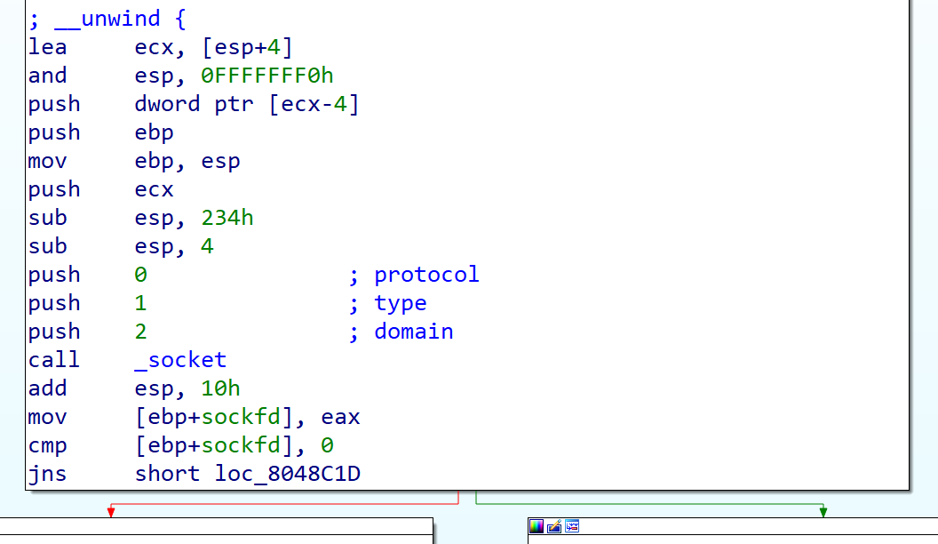
main(int argc, char **argv) IDA Pro

Slide 29
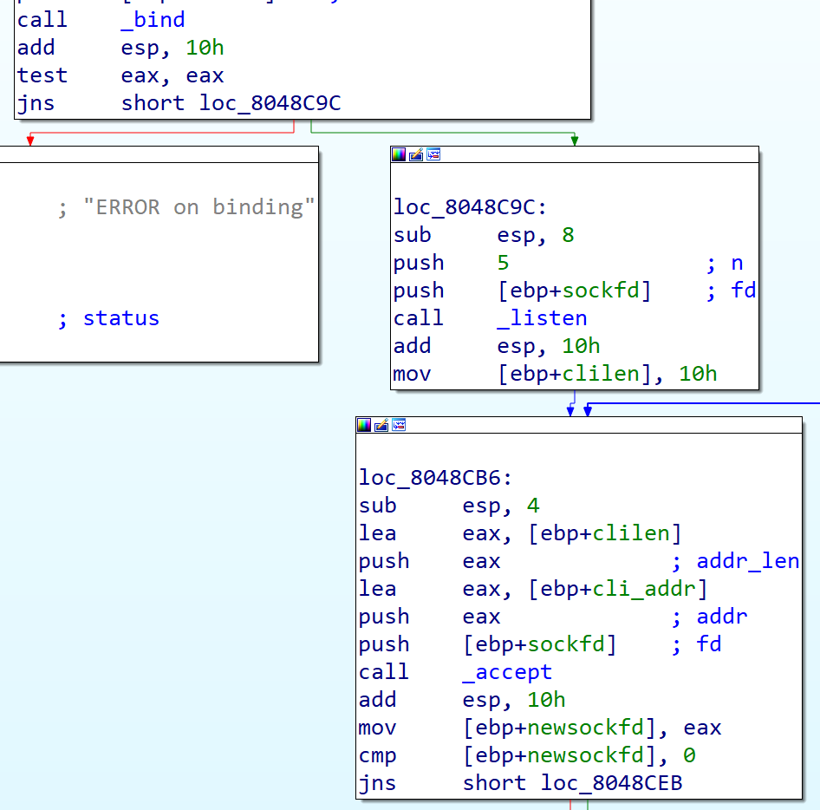
main(int argc, char **argv) IDA Pro

Slide 30
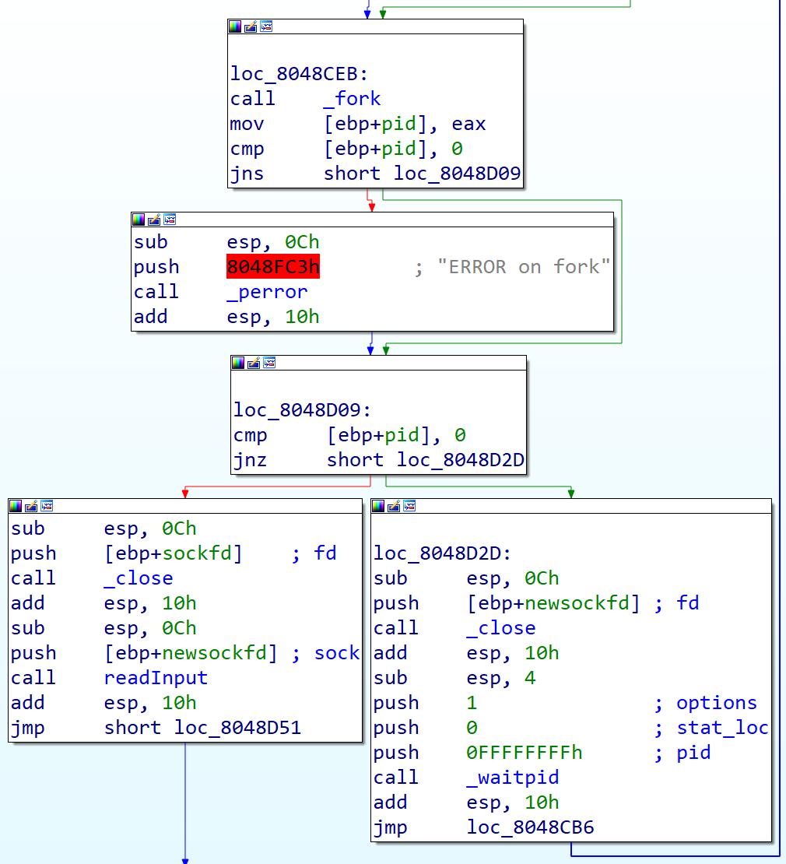
main(int argc, char **argv) IDA Pro

Slide 31
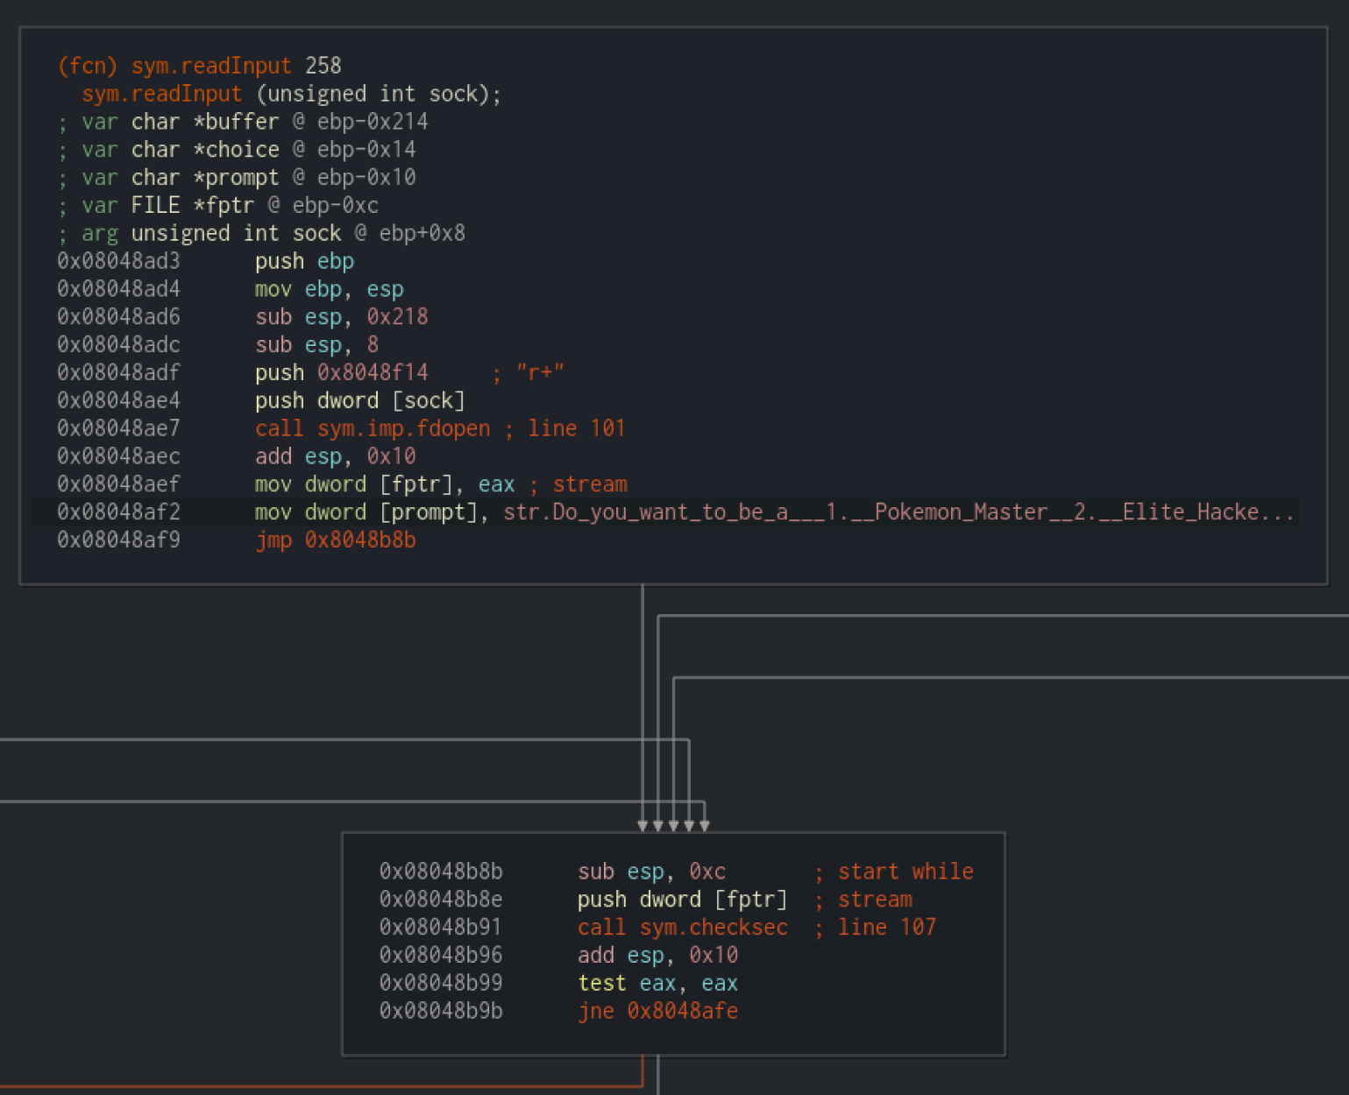
readInput(int sock) Radare2

Slide 32
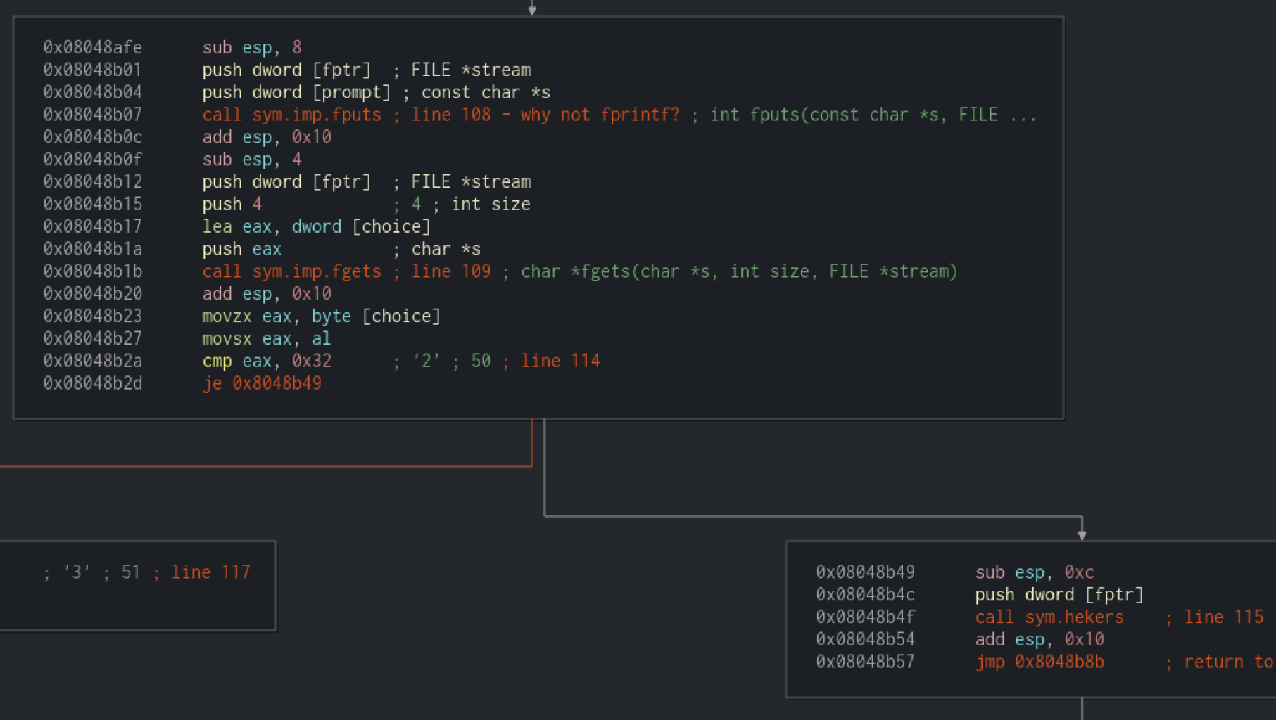
readInput(int sock) Radare2

Slide 33
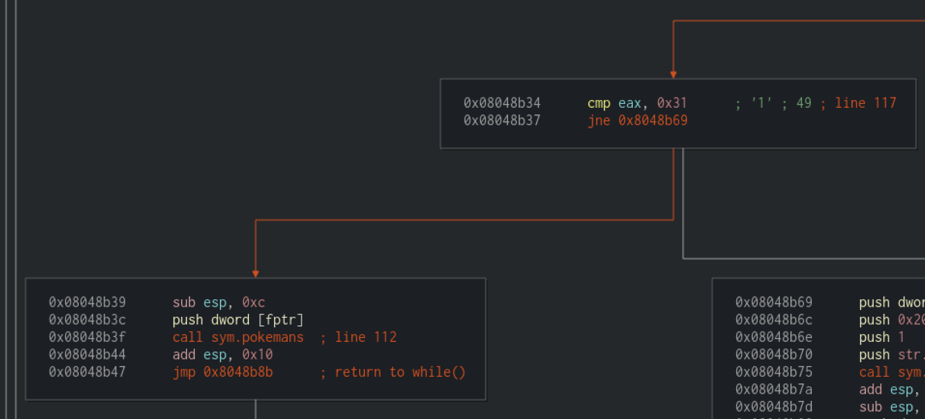
readInput(int sock) Radare2

Slide 34
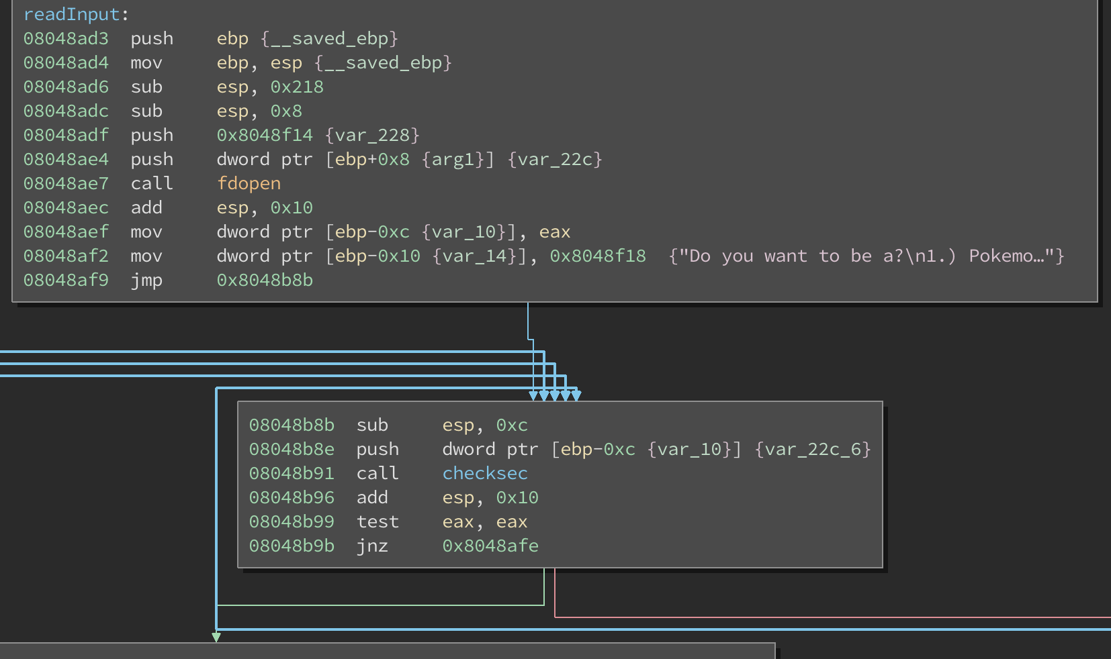
readInput(int sock) Binary Ninja

Slide 35
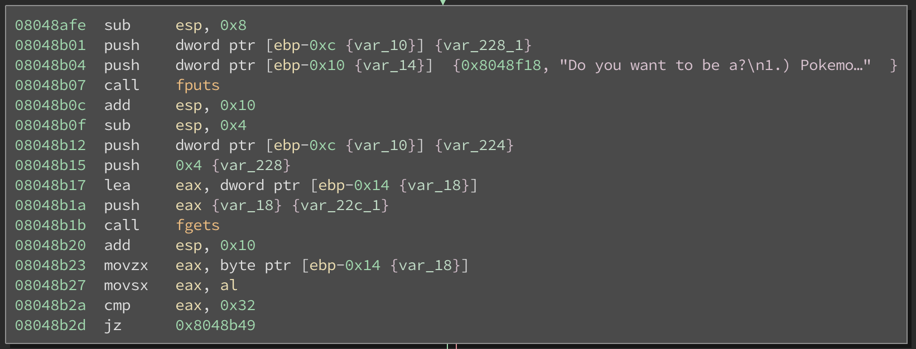
readInput(int sock) Binary Ninja

Slide 36
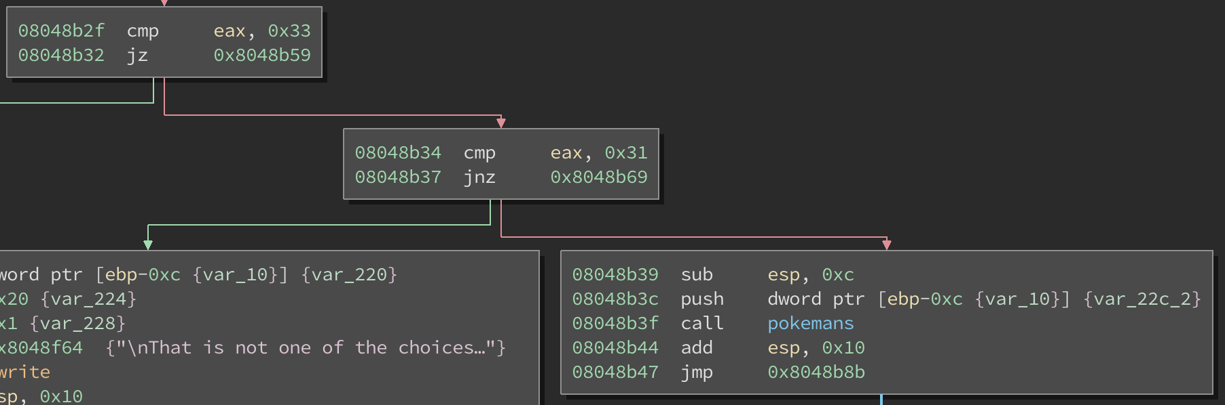
readInput(int sock) Binary Ninja

Slide 37
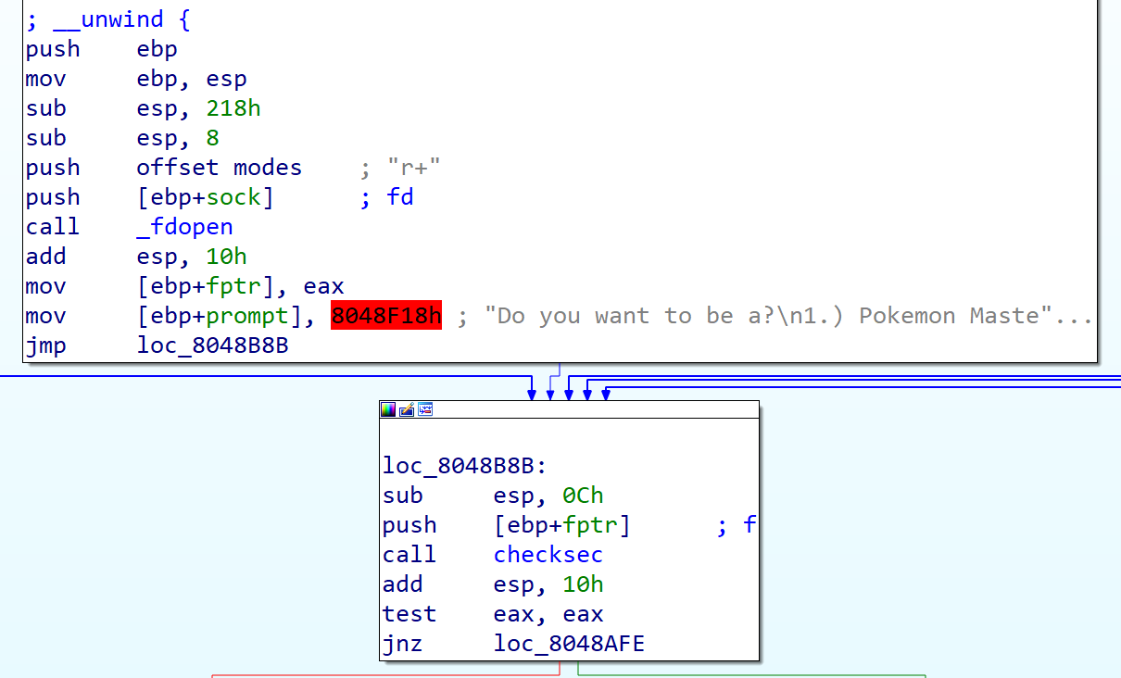
readInput(int sock) IDA Pro

Slide 38
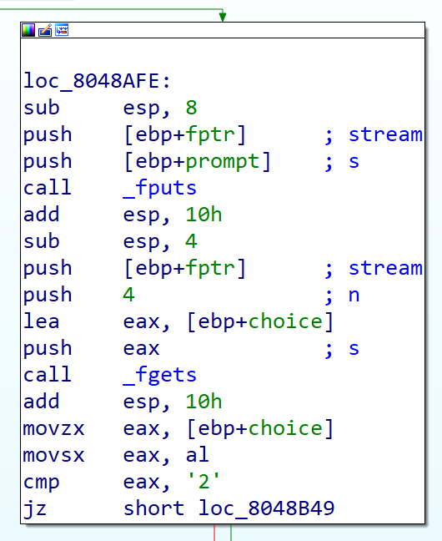
readInput(int sock) IDA Pro

Slide 39
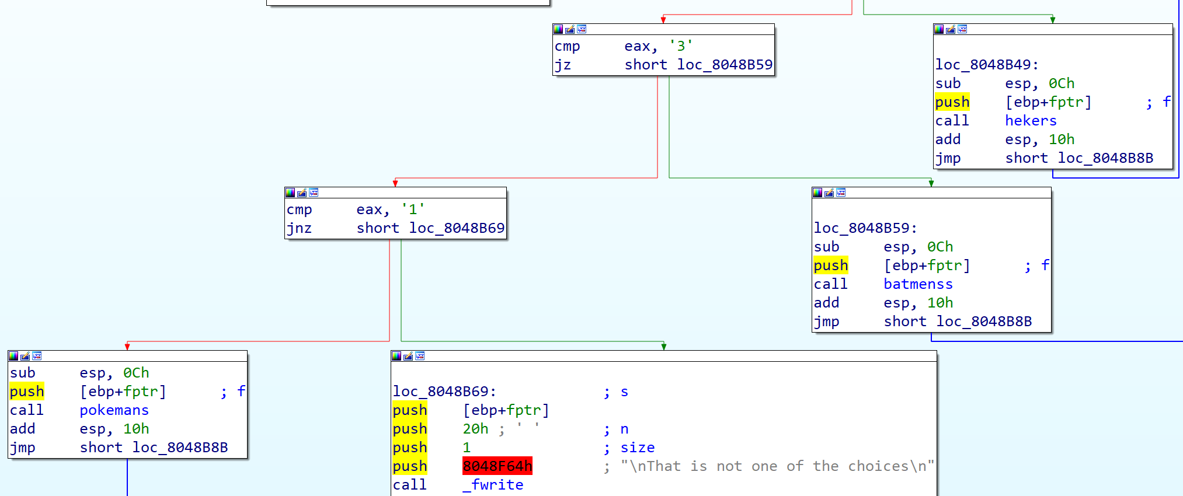
readInput(int sock) IDA Pro

Slide 40
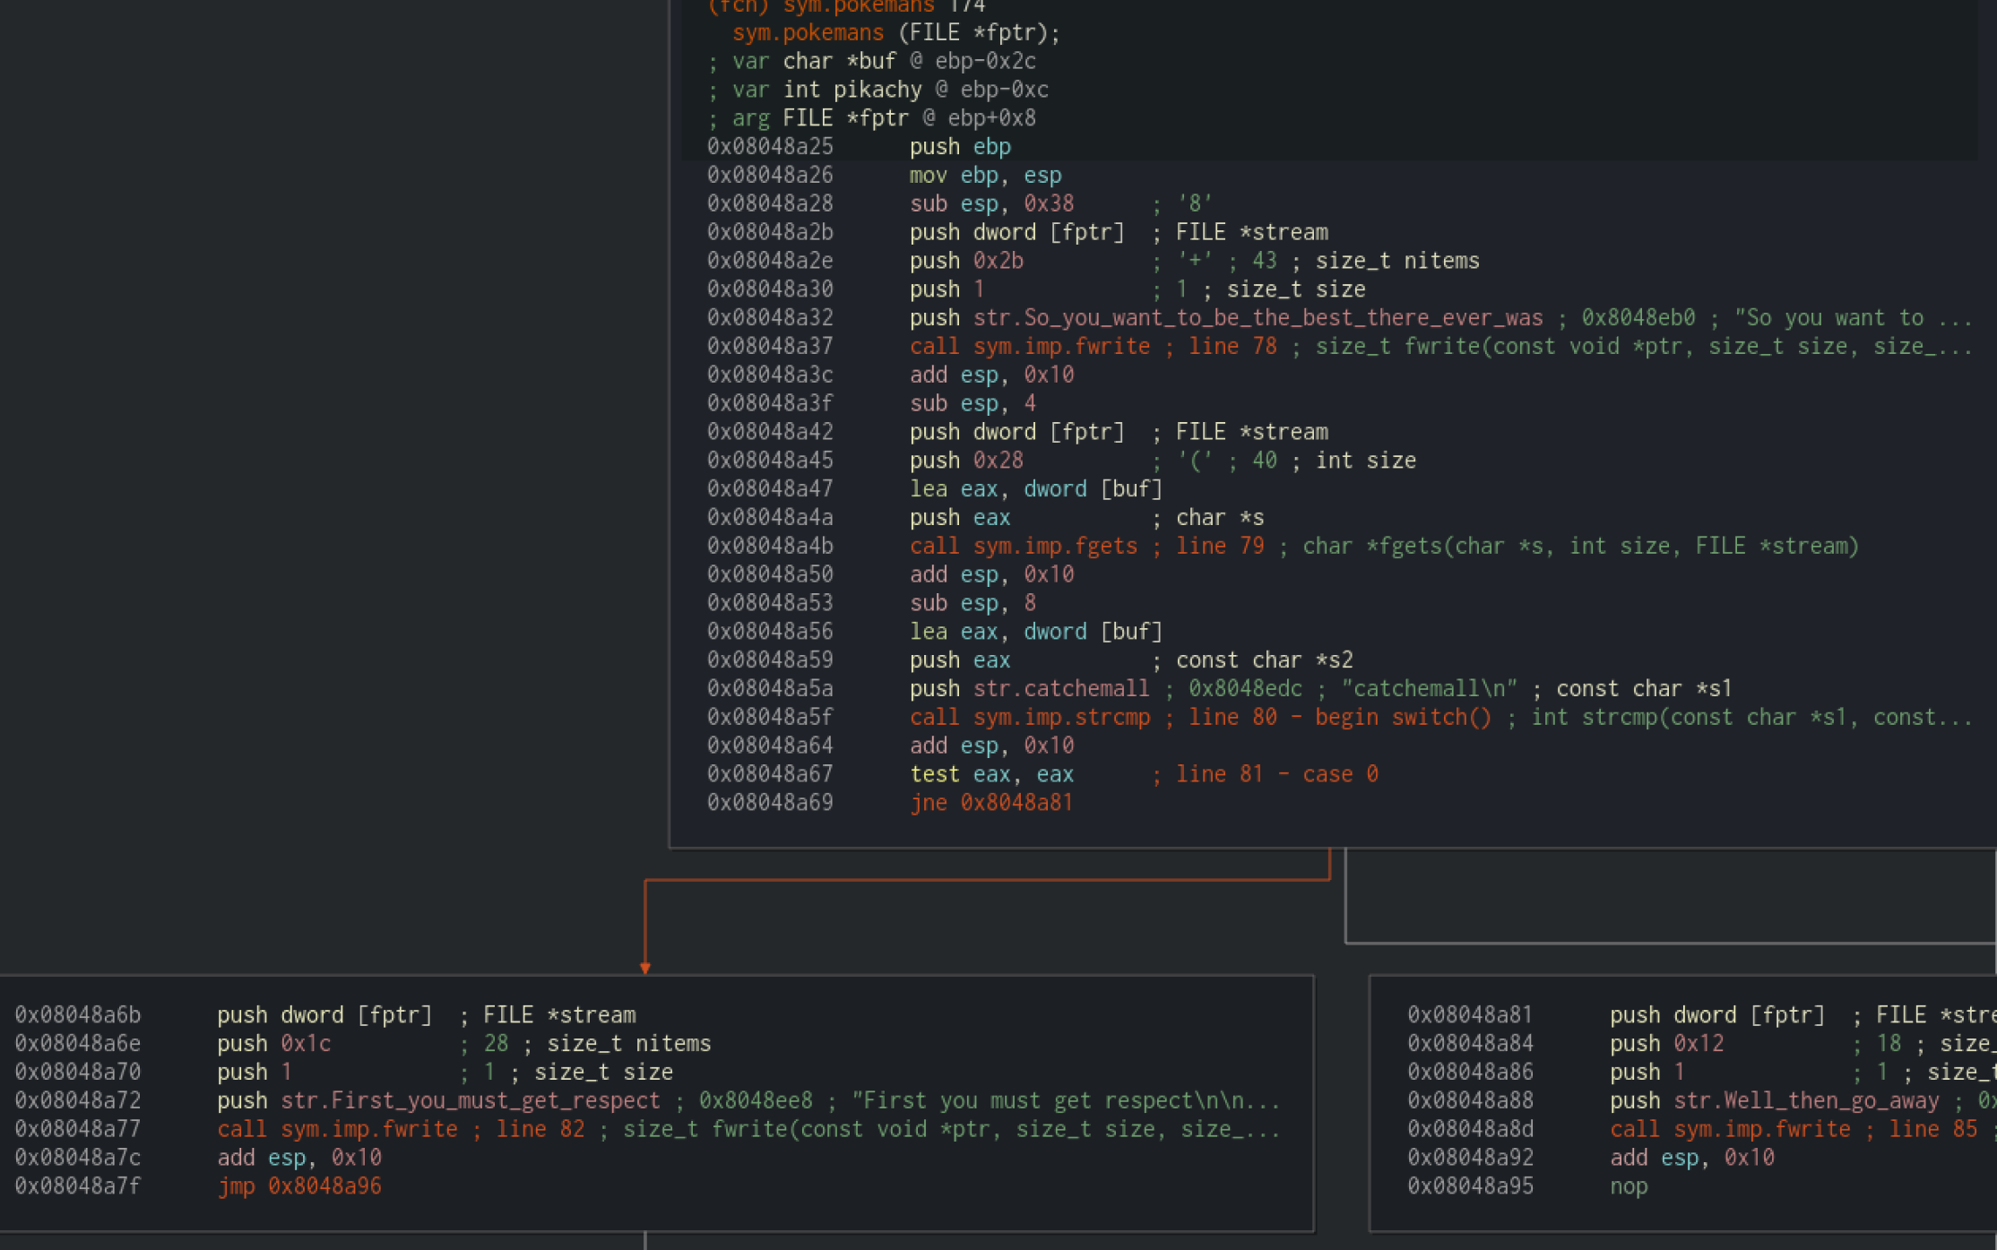
pokemans(FILE* f) Radare2

Slide 41
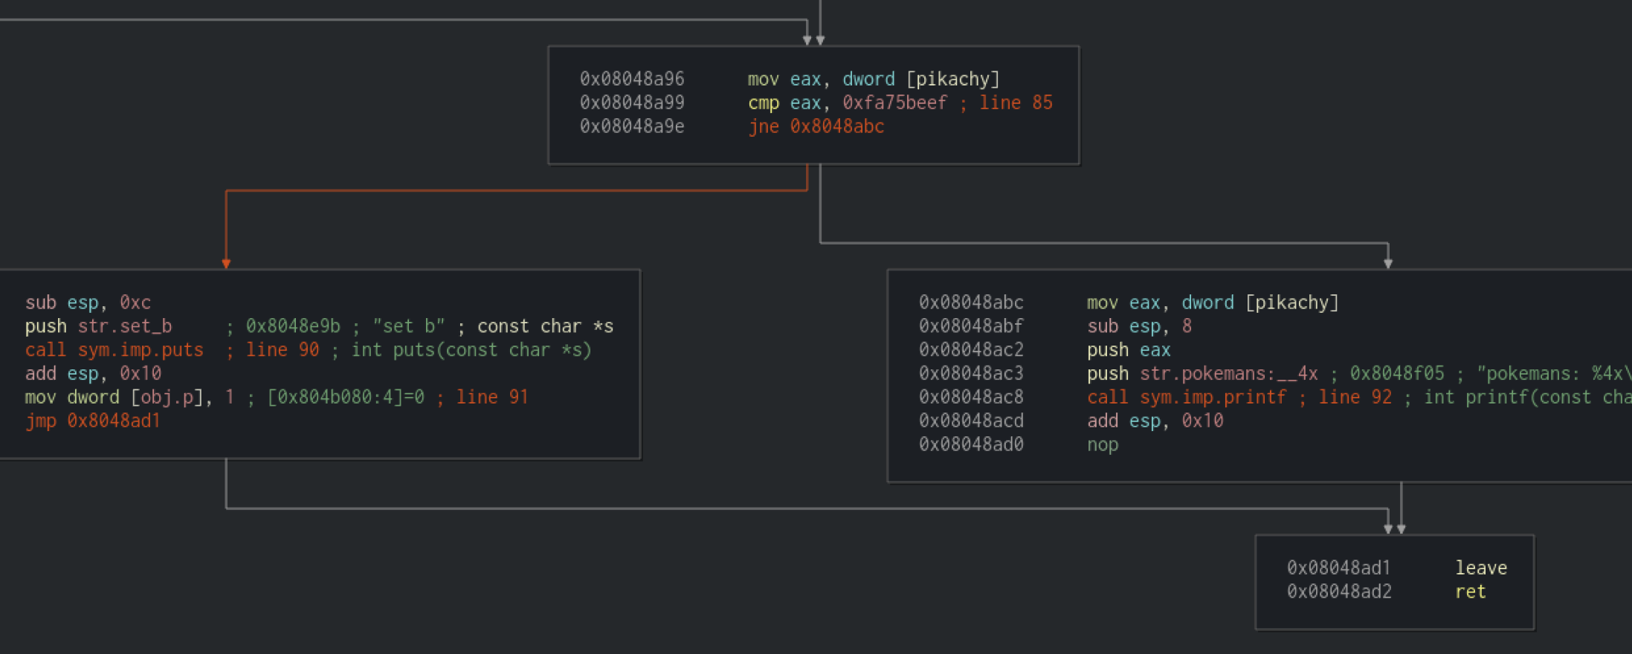
pokemans(FILE* f) Radare2

Slide 42
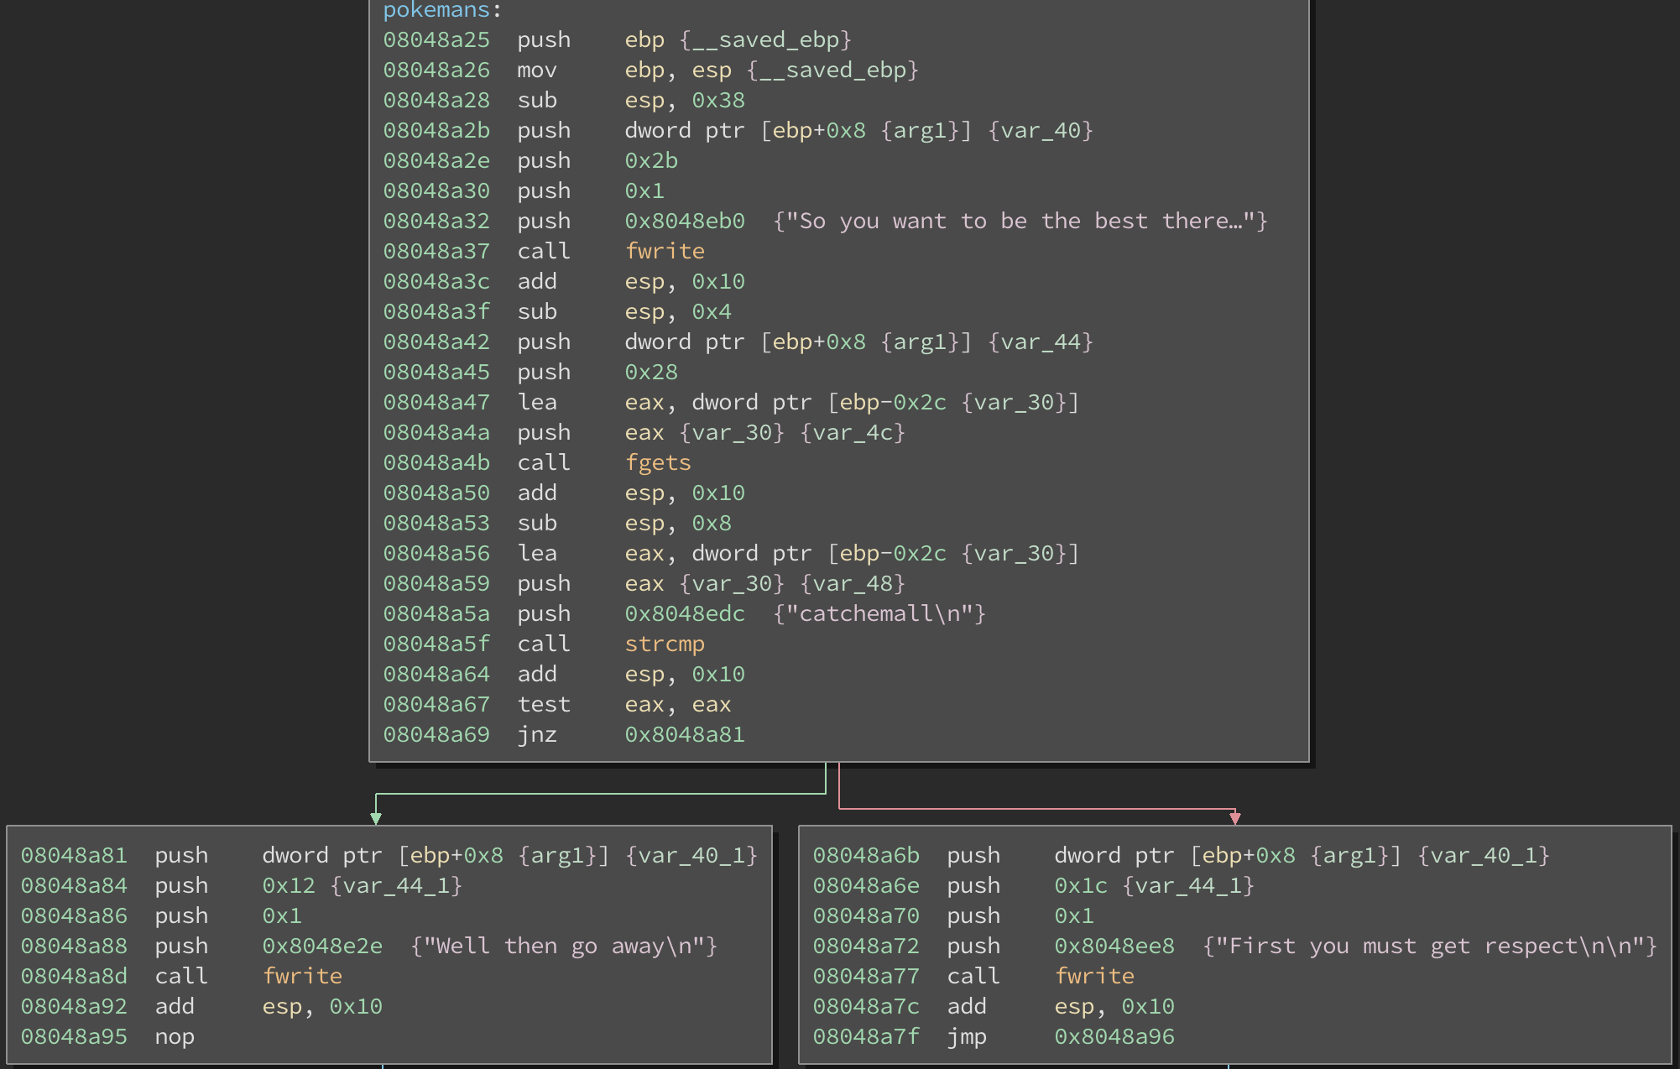
pokemans(FILE* f) Binary Ninja

Slide 43
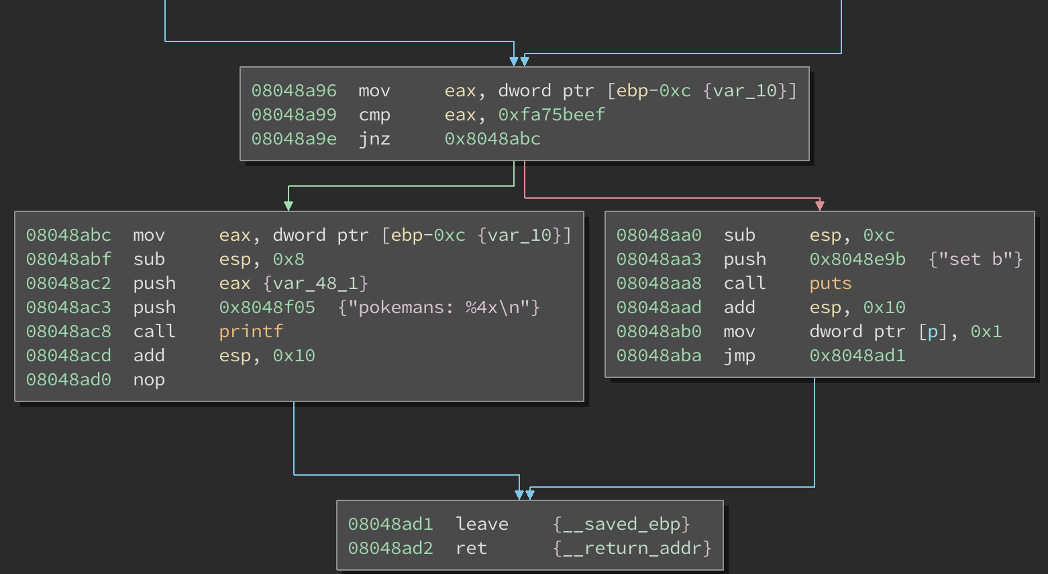
pokemans(FILE* f) Binary Ninja

Slide 44
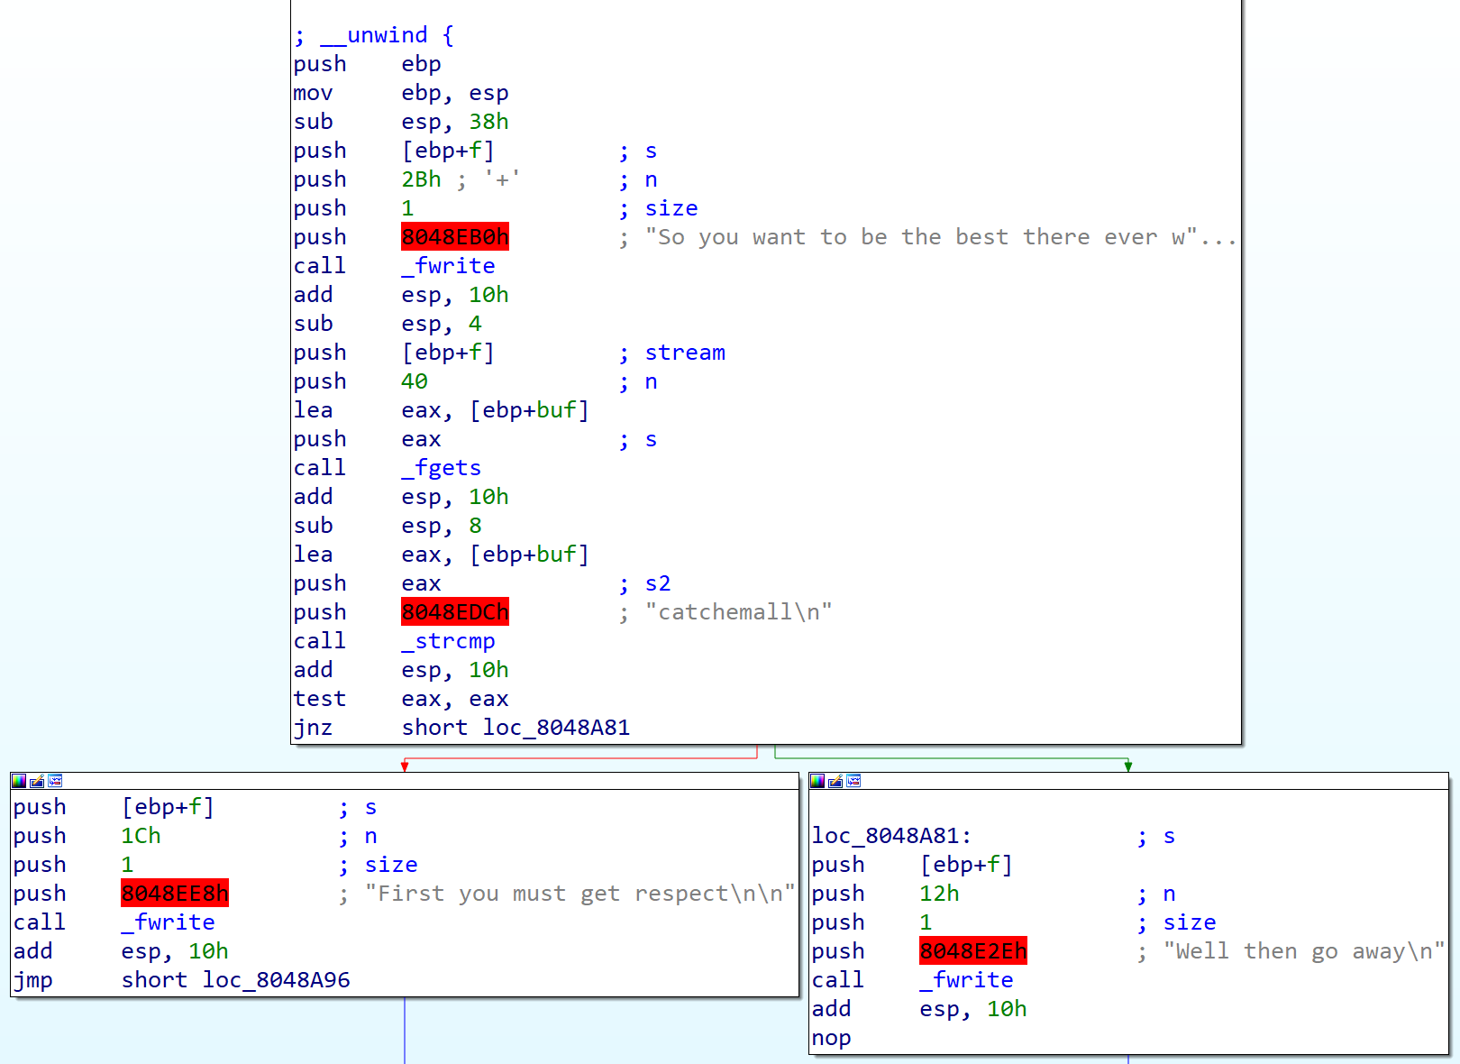
pokemans(FILE* f) IDA Pro

Slide 45
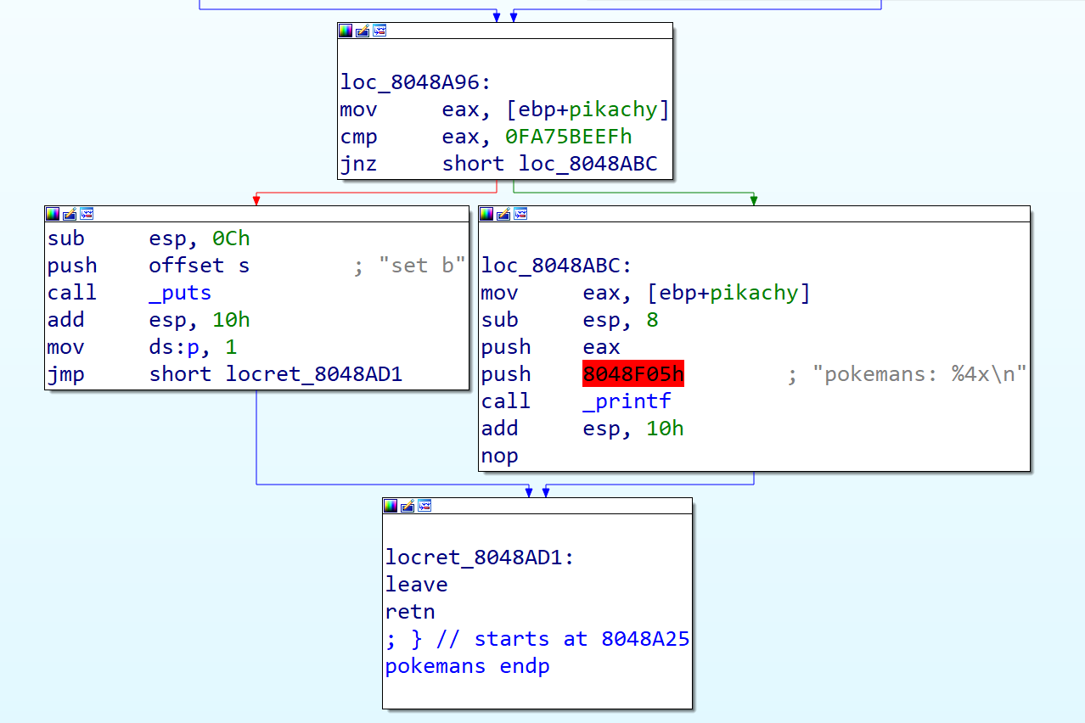
pokemans(FILE* f) IDA Pro

Slide 46
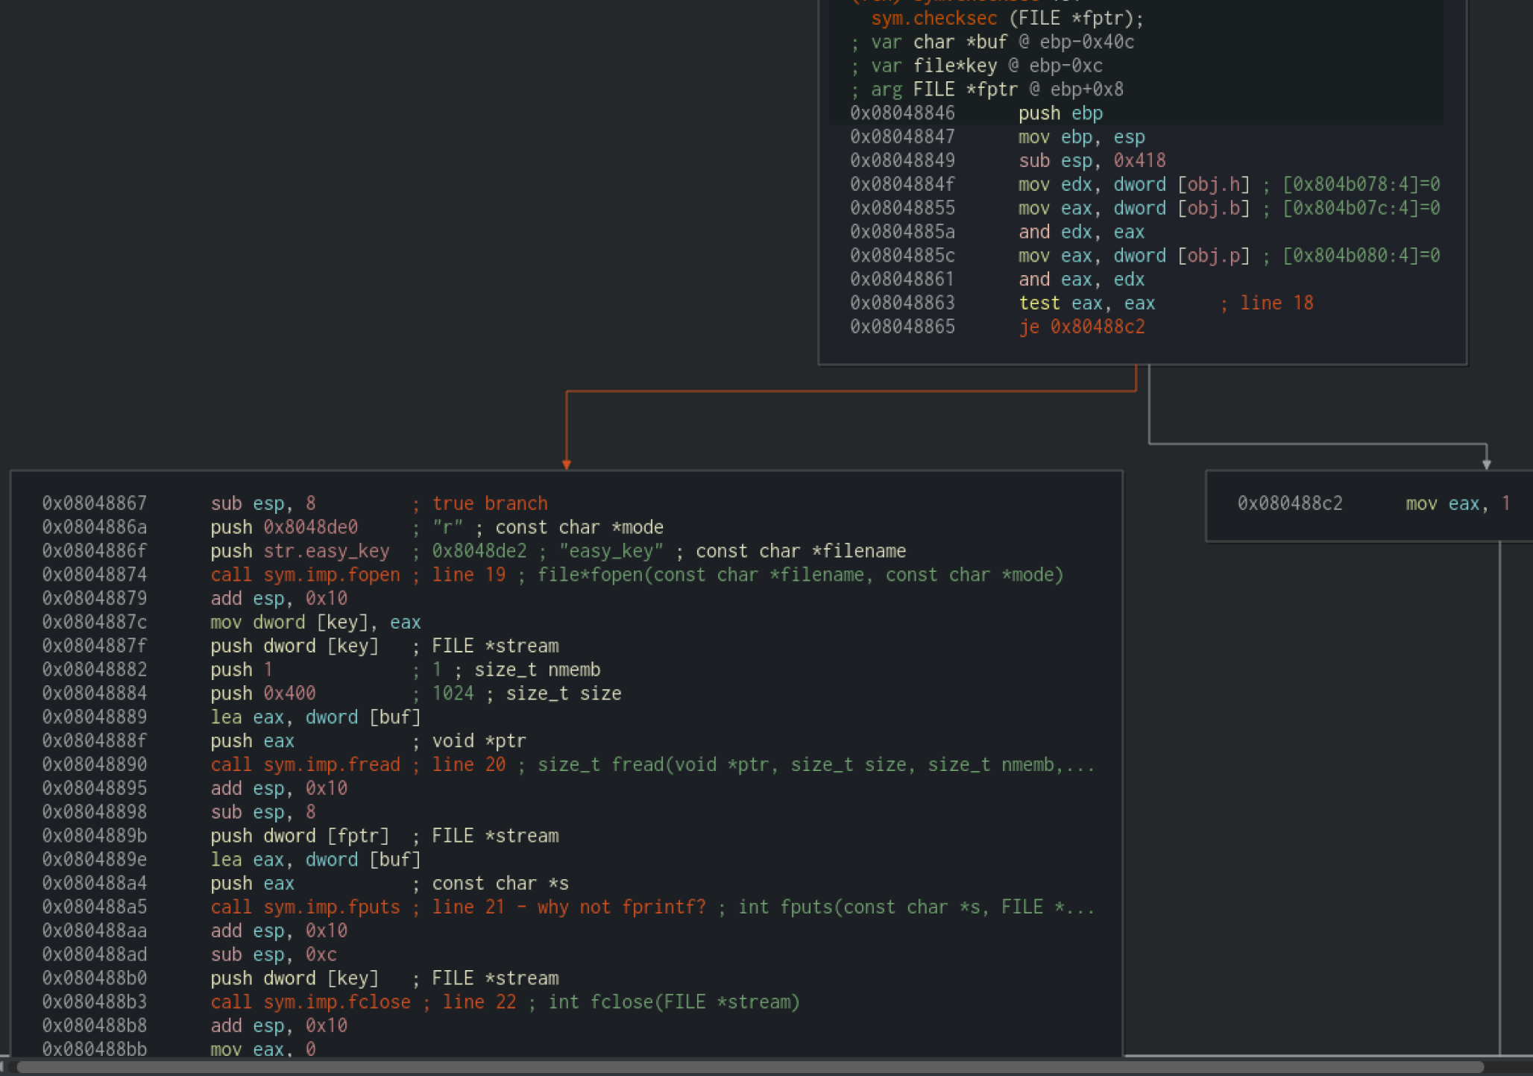
checksec(FILE* f) Radare2

Slide 47
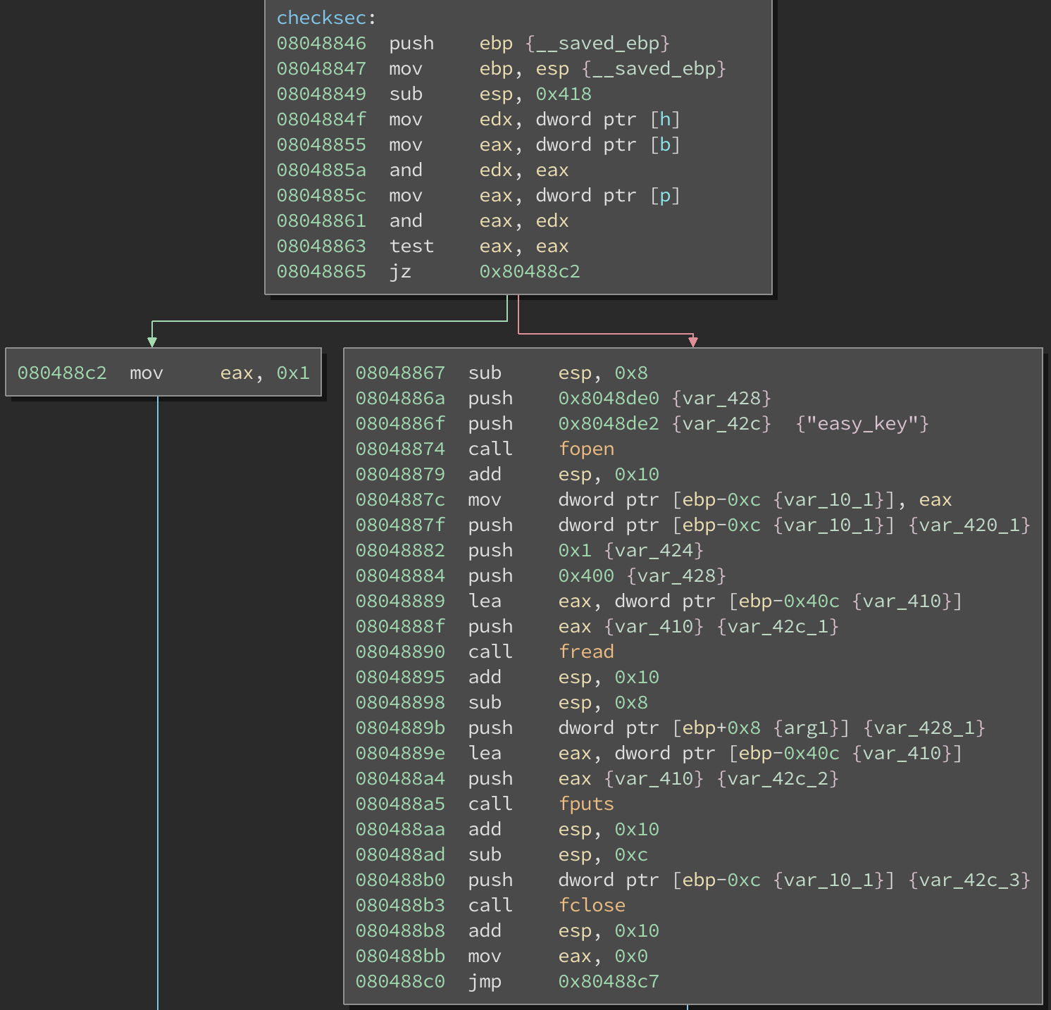
checksec(FILE* f) Binary Ninja

Slide 48
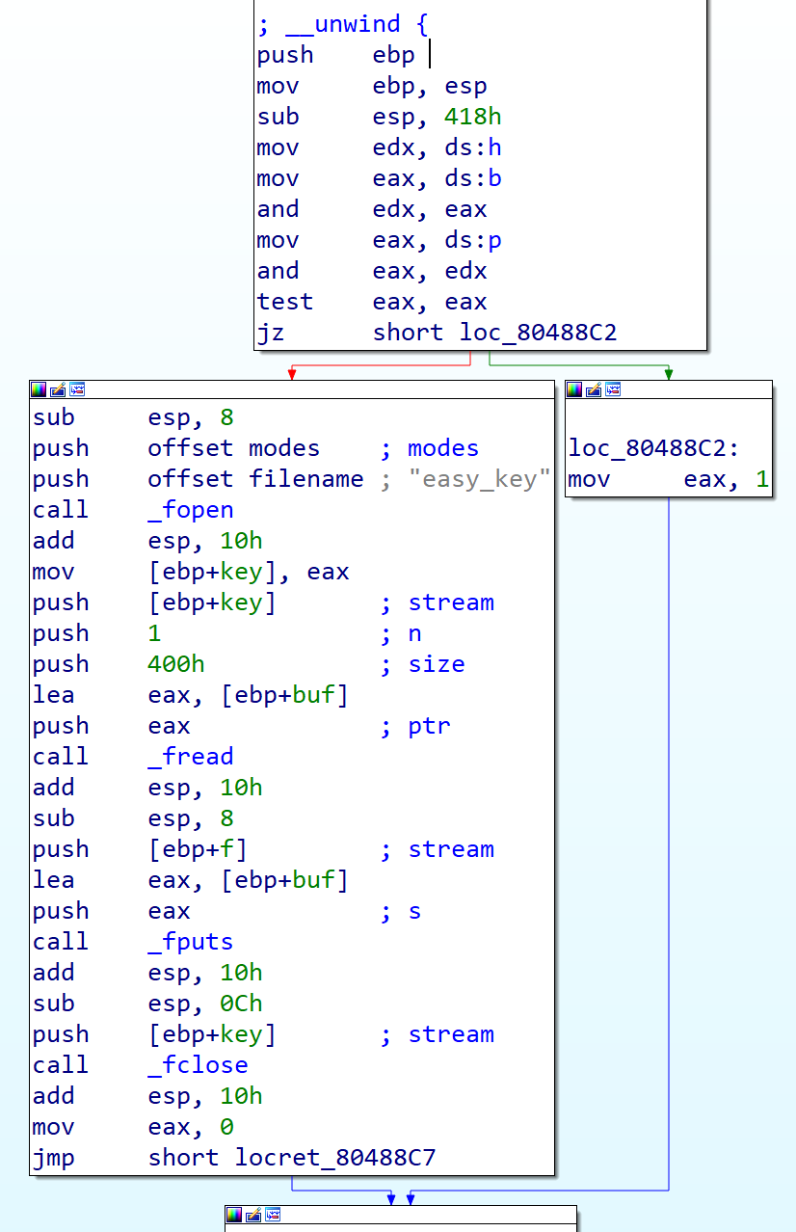
checksec(FILE* f) IDA Pro

Slide 49
Exploitation

Slide 50
Manual vs Scripted Debugging
Manual
Small/Simple binaries
Selective inspection of complex routines/binaries
Packed/Anti-reversing techniques
Automated
Large/Complex binaries
Automating statically interesting break points
Deep diving functionality for manual inspection

Slide 51
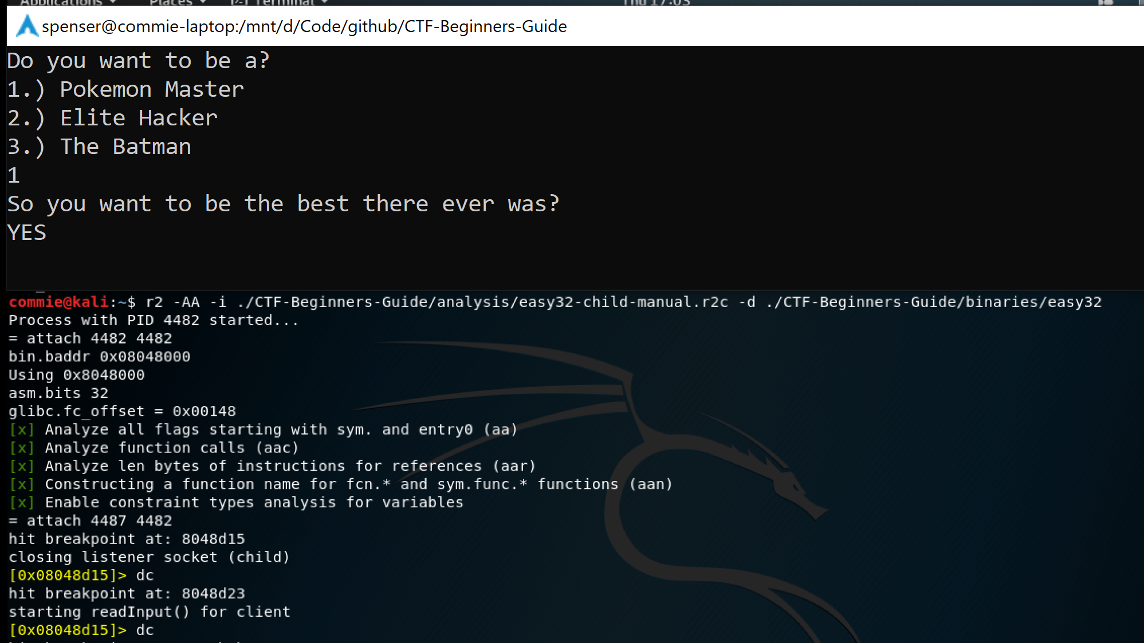
Loading Command Scripts

Slide 52
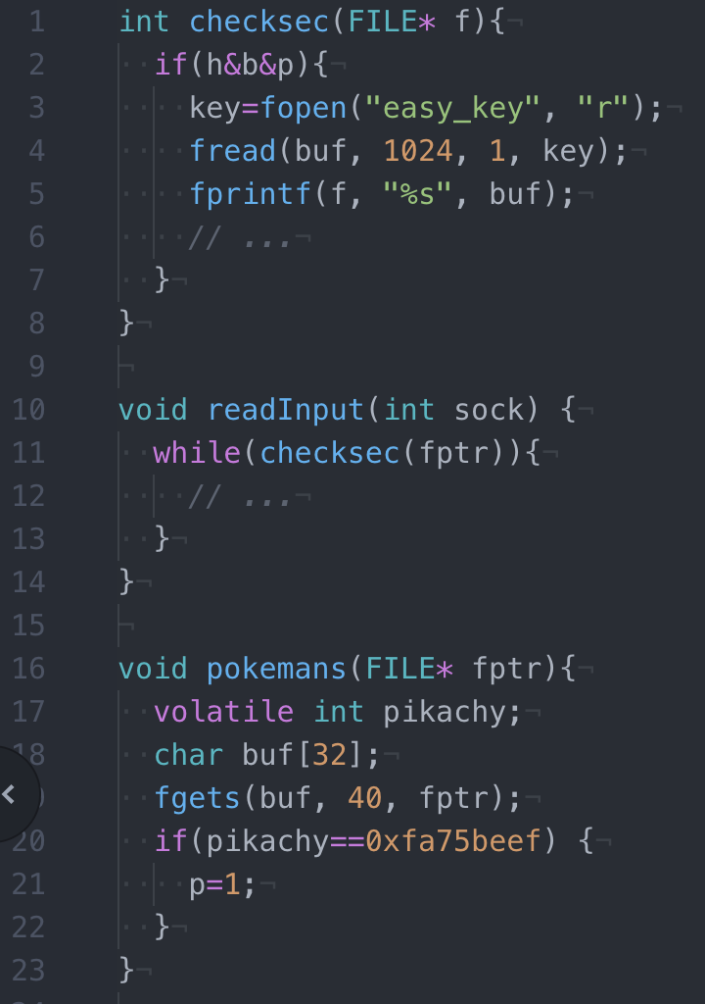
Getting the Flag

Slide 53
Stack Frames

Slide 54
Pokemans Stack Initial Layout
0xFFFFFFFF
Fn Parameter(s)
fptr
For Prior Frame
Saved EIP
Saved EBP
pikachy [ Uninitialized ]
buf[1C-1F] [ Uninitialized ]
buf[18-1B] [ Uninitialized ]
buf[14-17] [ Uninitialized ]
Local Variables
buf[10-13] [ Uninitialized ]
buf[0C-0F] [ Uninitialized ]
buf[08-0B] [ Uninitialized ]
buf[04-07] [ Uninitialized ]
buf[00-03] [ Uninitialized ]
0x00000000

Slide 55
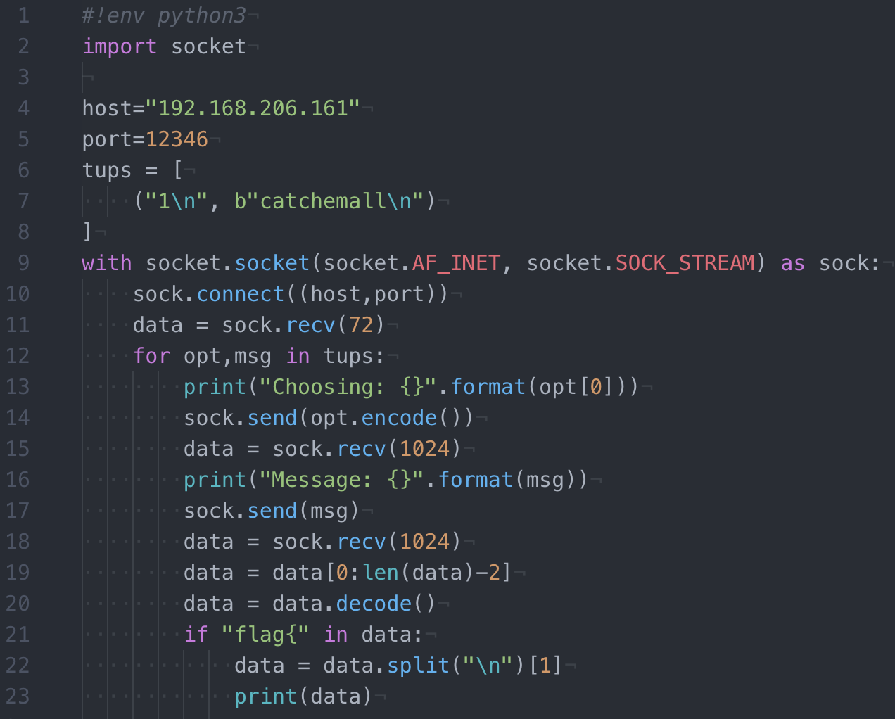
Exploit.py Answering the Question

Slide 56
Pokemans Stack Answering the Question
0xFFFFFFFF
Fn Parameter(s)
fptr
For Prior Frame
Saved EIP
Saved EBP
pikachy [ Uninitialized ]
buf[1C-1F] [ Uninitialized ]
buf[18-1B] [ Uninitialized ]
buf[14-17] [ Uninitialized ]
Local Variables
buf[10-13] [ Uninitialized ]
buf[0C-0F] [ Uninitialized ]
buf[08-0B] [ 74 61 63 ?? ]
tac
buf[04-07] [ 6D 65 68 63 ]
mehc
buf[00-03] [ 0A 6C 6C 61 ]
\nlla
0x00000000

Slide 57
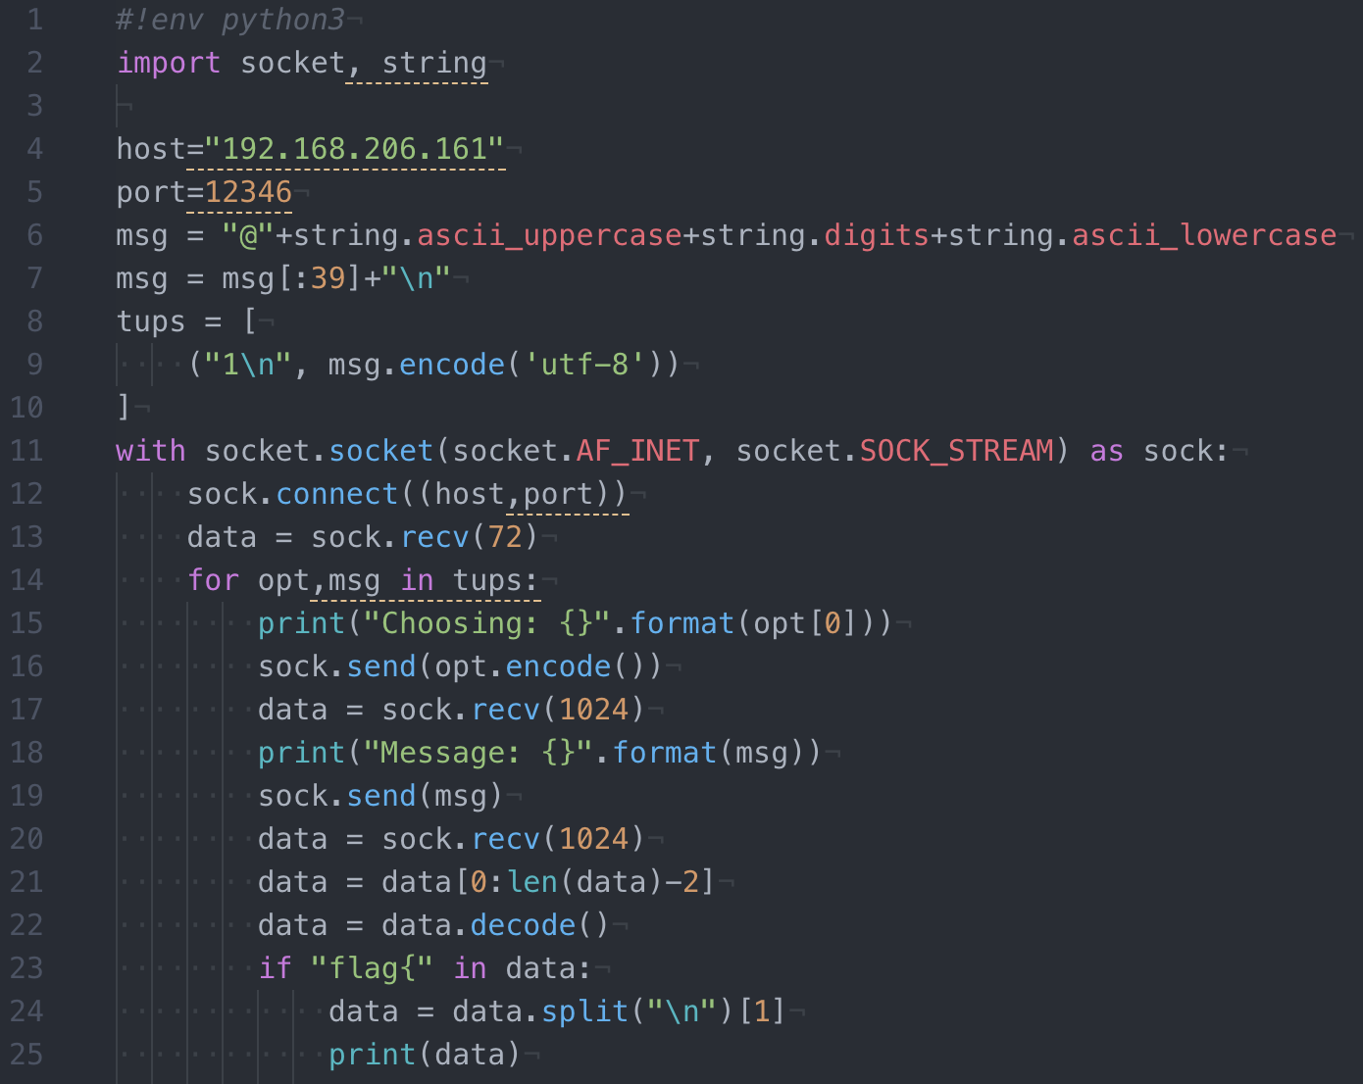
Exploit.py Sending 40 Bytes!

Slide 58
Pokemans Stack Sending 40 Bytes!
0xFFFFFFFF
Fn Parameter(s)
fptr
For Prior Frame
Saved EIP
Saved EBP [67 66 65 64]
pikachy [ 63 62 61 60 ]
buf[1C-1F] [ 5F 5E 5D 5C ]
buf[18-1B] [ 5B 5A 59 58 ]
buf[14-17] [ 57 56 55 54 ]
Local Variables
buf[10-13] [ 53 52 51 50 ]
buf[0C-0F] [ 4F 4E 4D 4C ]
buf[08-0B] [ 4B 4A 49 48 ]
buf[04-07] [ 47 46 45 44 ]
buf[00-03] [ 43 42 41 40]
0x00000000

Slide 59
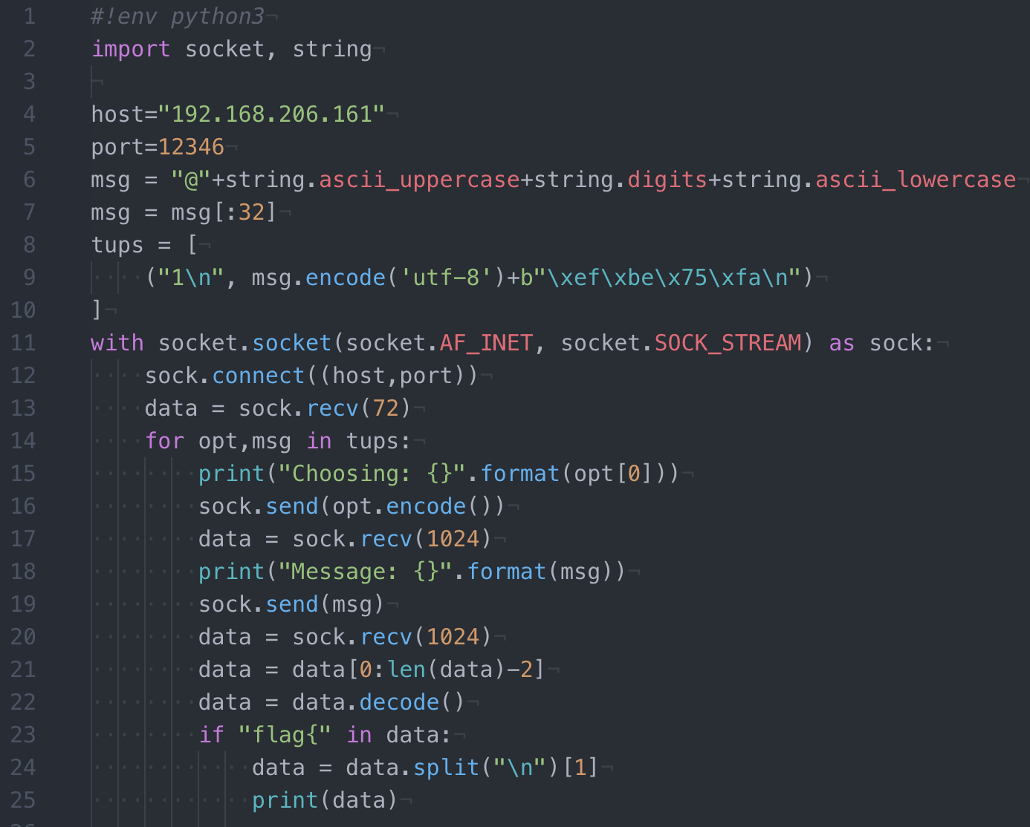
Exploit.py Overflowing… Just Right

Slide 60
Pokemans Stack Overflowing… Just Right
0xFFFFFFFF
Fn Parameter(s)
fptr
For Prior Frame
Saved EIP
Saved EBP
pikachy [ EF EB 75 FA ]
buf[1C-1F] [ 5F 5E 5D 5C ]
buf[18-1B] [ 5B 5A 59 58 ]
buf[14-17] [ 57 56 55 54 ]
Local Variables
buf[10-13] [ 53 52 51 50 ]
buf[0C-0F] [ 4F 4E 4D 4C ]
buf[08-0B] [ 4B 4A 49 48 ]
buf[04-07] [ 47 46 45 44 ]
buf[00-03] [ 43 42 41 40]
0x00000000

Slide 61
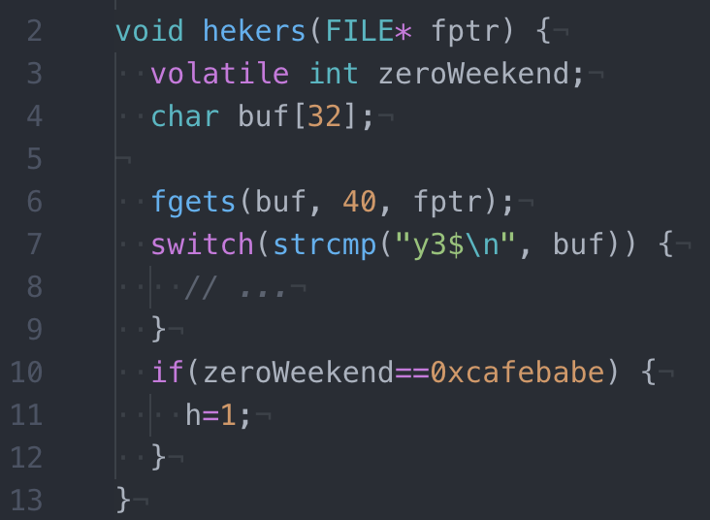
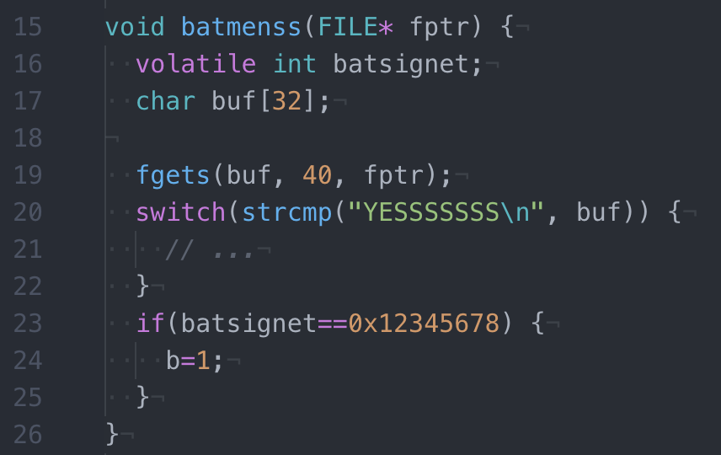
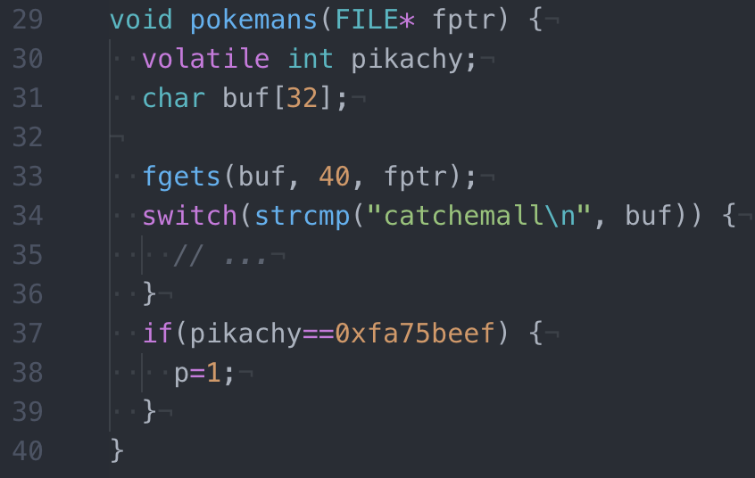
Vulnerable Functions

Slide 62
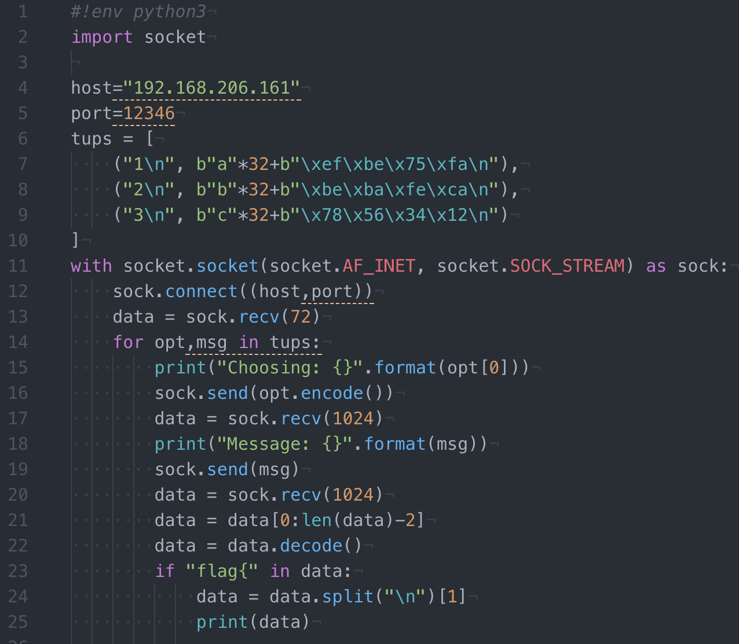
Complete Exploit

